Slide 1
Origins:
Is It Reasonable To Believe in God in This Scientific Age?
Notes:
1

Slide 2
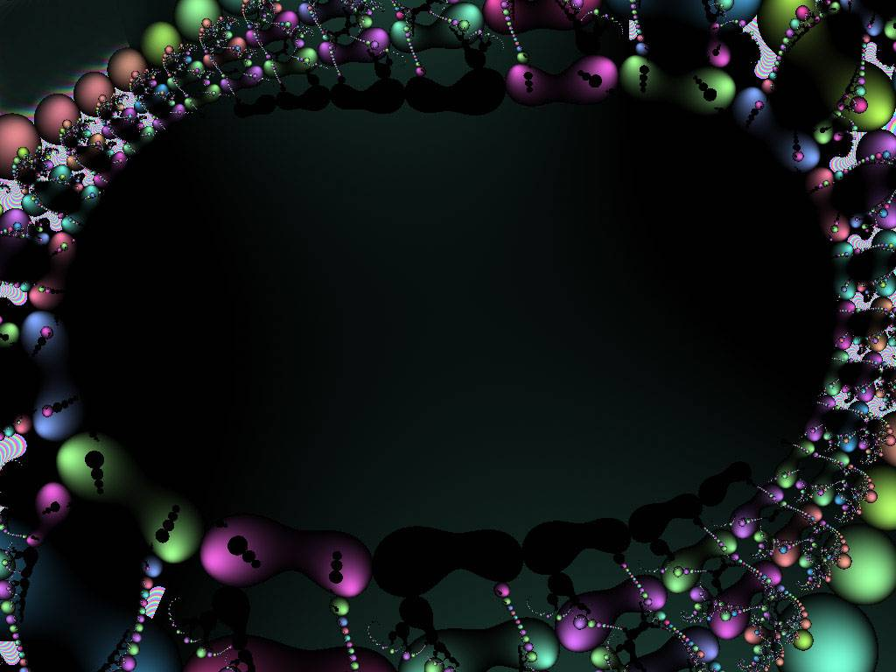
Design at the
Microscopic Level
The Signature in the Cell

Slide 3
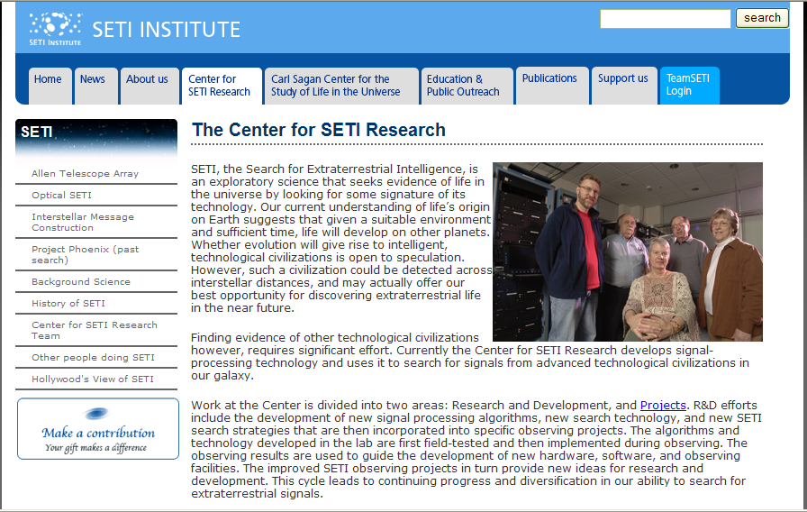
Search for Extra Terrestrial Intelligence - SETI
SETI, the Search for Extraterrestrial Intelligence, is an exploratory science that seeks evidence of life in the universe by looking for some signature of its technology…

Slide 4
Signal Received from Space
SETI
Search for Extra - Terrestrial Intelligence
What if we received a message from space with a language we could decode and read?
Notes:
45

Slide 5
Signs of Intelligent Design Right Here on Earth
Every living cell is full of signs of intelligent design.
Including a language which we have learned to decode and read!

Slide 6
  Anthony Flew
  Professor of Philosophy
  Former atheist, author and debater
  2004
  “It now seems to me that the findings of more than fifty years of DNA research have provide materials for a new and enormously powerful argument to design.”

Slide 7
Signs of Intelligent Design Right Here on Earth
Every living cell is full of signs of intelligent design.
Including a language which we have learned to decode and read!
Research on DNA continues to reveal signs of DESIGN.
Anthony Flew “had to go where the evidence leads.”

Slide 8
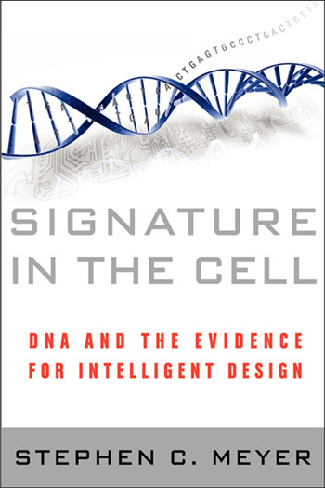
Signature in the Cell by
Dr. Stephen C. Meyer
2009
Notes:
1

Slide 9
Judge
Natural Causes
Intelligent Design
Which is more reasonable?
Theory
A
Theory
B
EVIDENCE
Facts of nature

Slide 10
Critical Components of Life
Components
Assembled
Organic Compounds
Function
Structural Materials
Proteins
(assembled from amino acids)
Construction
(shape and mobility)
Tools and Machinery
Enzymes
(special forms of proteins)
Metabolism
(growth and maintenance)
Blueprints
Genes - Nucleic Acid
(DNA and RNA)
Reproduction
(information and directive function)
Notes:
28

Slide 11
Two Types of Proteins
Structural
Enzymes
Workhorses
Notes:
30

Slide 12
The Twenty Common Amino Acids Occurring in Proteins
Glycine (Gly)
Alanine (Ala)
Valine (Val)
Leucine (Leu)
Isoleucine (Ileu)
NH₃
NH₃
CH₃
NH₃
CH₃
NH₃
CH₃
NH₃
-
⁺
-
⁺
-
-
⁺
-
-
⁺
-
-
⁺
H-CH-COO⁻
CH₃-CH-COO⁻
CH₃ CH - CH-COO⁻
CH₃CH CH₂-CH-COO⁻
CH₃CH₂CH - CH-COO⁻
Proline (Pro)
Serine (Ser)
Threonine (Thr)
Aspartic acid
(Asp)
Asparagine
(Asp N)
CH₂
OH
NH₃
OH
NH₃
COOH
NH₃
CO NH₂
NH₃
NH₂
⁺
⁺
⁺
⁺
CH₂
-
⁺
-
-
-
-
-
-
-
-
CH-COO⁻
CH₂-CH-COO⁻
CH₃ CH - CH-COO⁻
CH₂ - CH - COO⁻
CH₂ - CH - COO⁻
CH₂
Glutamic acid
(Glu)
Glutamine (Glu N)
Lysine (Lys)
Arginine (Arg)
Cysteine (CySH)
COOH
NH₃
CO NH₂
NH₃
NH₂
NH₃
NH₂
NH₃
SH
NH₃
-
-
⁺
-
-
⁺
-
-
⁺
-
-
⁺
-
-
⁺
CH₂
CH₂-CH-COO⁻
CH₂
CH₂-CH-COO⁻
CH₂CH₂CH₂
CH₂-CH-COO⁻
CNH CH₂CH₂
CH₂-CH-COO⁻
CH₂-CH-COO⁻
-
-
NH
Methionine (Met)
Phenylalanine
(Phe)
Tyrosine (Tyr)
Tryptophan
(Try)
Histidine (His)
NH₃
S-CH₃
NH₃
NH₃
NH₃
⁺
N
CH
NH₃
⁺
⁺
⁺
-
-
-
⁺
-
-
-
-
-
-
C-
-
CH₂-CH-COO⁻
C
C-
-
H
CH₂-CH-COO⁻
CH₂
CH₂-CH-COO⁻
CH₂-CH-COO⁻
HO
CH₂-CH-COO⁻
-
CH
N
N
-
-
H
H
Notes:
31

Slide 13
The Twenty Common Amino Acids Occurring in Proteins
Glycine (Gly)
Alanine (Ala)
Valine (Val)
Leucine (Leu)
Isoleucine (Ileu)
NH₃
NH₃
CH₃
NH₃
CH₃
NH₃
CH₃
NH₃
-
⁺
-
⁺
-
-
⁺
-
-
⁺
-
-
⁺
H-CH-COO⁻
CH₃-CH-COO⁻
CH₃ CH - CH-COO⁻
CH₃CH CH₂-CH-COO⁻
CH₃CH₂CH - CH-COO⁻
Proline (Pro)
Serine (Ser)
Threonine (Thr)
Aspartic acid (Asp)
Asparagine (Asp N)
CH₂
Every protein is a
combination of these 20.
OH
NH₃
OH
NH₃
COOH
NH₃
CO NH₂
NH₃
NH₂
⁺
⁺
⁺
⁺
CH₂
-
⁺
-
-
-
-
-
-
-
-
CH-COO⁻
CH₂-CH-COO⁻
CH₃ CH - CH-COO⁻
CH₂ - CH - COO⁻
CH₂ - CH - COO⁻
CH₂
Glutamic acid (Glu)
Glutamine (Glu N)
Lysine (Lys)
Arginine (Arg)
Cysteine (CySH)
COOH
NH₃
CO NH₂
NH₃
NH₂
NH₃
NH₂
NH₃
SH
NH₃
-
-
⁺
-
-
⁺
-
-
⁺
-
-
⁺
-
-
⁺
CH₂
CH₂-CH-COO⁻
CH₂
CH₂-CH-COO⁻
CH₂CH₂CH₂
CH₂-CH-COO⁻
CNH CH₂CH₂
CH₂-CH-COO⁻
CH₂-CH-COO⁻
-
-
NH
Methionine (Met)
Phenylalanine (Phe)
Tyrosine (Tyr)
Tryptophan (Try)
Histidine (His)
NH₃
S-CH₃
NH₃
NH₃
NH₃
⁺
N
CH
NH₃
⁺
⁺
⁺
-
-
-
⁺
-
-
-
-
-
-
C-
-
CH₂-CH-COO⁻
C
C-
-
H
CH₂-CH-COO⁻
CH₂
CH₂-CH-COO⁻
CH₂-CH-COO⁻
HO
CH₂-CH-COO⁻
-
CH
N
N
-
-
H
H
Notes:
32

Slide 14
The Twenty Common Amino Acids Occurring in Proteins
Glycine (Gly)
Alanine (Ala)
Valine (Val)
Leucine (Leu)
Isoleucine (Ileu)
NH₃
NH₃
CH₃
NH₃
CH₃
NH₃
CH₃
NH₃
-
⁺
-
⁺
-
-
⁺
-
-
⁺
-
-
⁺
H-CH-COO⁻
CH₃-CH-COO⁻
CH₃ CH - CH-COO⁻
CH₃CH CH₂-CH-COO⁻
CH₃CH₂CH - CH-COO⁻
Proline (Pro)
Serine (Ser)
Threonine (Thr)
Aspartic acid (Asp)
Asparagine (Asp N)
CH₂
OH
NH₃
OH
NH₃
COOH
NH₃
CO NH₂
NH₃
⁺
⁺
⁺
⁺
NH₂
Like the 26 letters of the alphabet which make up our words
CH₂
-
⁺
-
-
-
-
-
-
-
-
CH-COO⁻
CH₂-CH-COO⁻
CH₃ CH - CH-COO⁻
CH₂ - CH - COO⁻
CH₂ - CH - COO⁻
CH₂
Glutamic acid (Glu)
Glutamine (Glu N)
Lysine (Lys)
Arginine (Arg)
Cysteine (CySH)
COOH
NH₃
CO NH₂
NH₃
NH₂
NH₃
NH₂
NH₃
SH
NH₃
-
-
⁺
-
-
⁺
-
-
⁺
-
-
⁺
-
-
⁺
CH₂
CH₂-CH-COO⁻
CH₂
CH₂-CH-COO⁻
CH₂CH₂CH₂
CH₂-CH-COO⁻
CNH CH₂CH₂
CH₂-CH-COO⁻
CH₂-CH-COO⁻
-
-
NH
Methionine (Met)
Phenylalanine (Phe)
Tyrosine (Tyr)
Tryptophan (Try)
Histidine (His)
NH₃
S-CH₃
NH₃
NH₃
NH₃
⁺
N
CH
NH₃
⁺
⁺
⁺
-
-
-
⁺
-
-
-
-
-
-
C-
-
CH₂-CH-COO⁻
C
C-
-
H
CH₂-CH-COO⁻
CH₂
CH₂-CH-COO⁻
CH₂-CH-COO⁻
HO
CH₂-CH-COO⁻
-
CH
N
N
-
-
H
H
Notes:
33

Slide 15
Dumb Blondes of the Biochemical World
Dr. Francis Crick in Life Itself
DNA
RNA
Notes:
29

Slide 16
DNA
Certain characteristic structure
Double helix with cross bars
Capacity to reproduce itself
Notes:
46

Slide 17
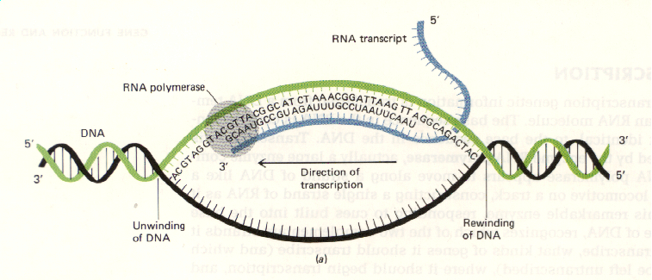
A DNA double helix is unwound by RNA polymerase, giving the enzyme access to the nucleotide sequence.

Slide 18
Genetic Code
First Base
Second Base
Third Base
U
C
A
G
phenylalanine
serine
tyrosine
cysteine
U
phenylalanine
serine
tyrosine
cysteine
C
U
leucine
serine
stop
stop
A
leucine
serine
stop
tryptophan
G
leucine
proline
histidine
arginine
U
leucine
proline
histidine
arginine
C
C
leucine
proline
glutamine
arginine
A
leucine
proline
glutamine
arginine
G
isoleucine
threonine
asparagine
serine
U
isoleucine
threonine
asparagine
serine
C
A
isoleucine
threonine
lysine
arginine
A
(start)
methionine
threonine
lysine
arginine
G
valine
alanine
aspartate
glycine
U
valine
alanine
aspartate
glycine
C
G
valine
alanine
glutamate
glycine
A
valine
alanine
glutamate
glycine
G
Notes:
49

Slide 19
Genetic Code
First Base
Second Base
Third Base
U
C
A
G
phenylalanine
serine
tyrosine
cysteine
U
phenylalanine
serine
tyrosine
cysteine
C
U
leucine
serine
stop
stop
A
leucine
serine
stop
tryptophan
G
leucine
proline
histidine
arginine
U
All 20 Amino Acids are Coded Here
C
leucine
proline
histidine
arginine
C
leucine
proline
glutamine
arginine
A
leucine
proline
glutamine
arginine
G
isoleucine
threonine
asparagine
serine
U
isoleucine
threonine
asparagine
serine
C
A
isoleucine
threonine
lysine
arginine
A
(start)
methionine
threonine
lysine
arginine
G
valine
alanine
aspartate
glycine
U
valine
alanine
aspartate
glycine
C
G
valine
alanine
glutamate
glycine
A
valine
alanine
glutamate
glycine
G
Notes:
49

Slide 20
Genetic Code
First Base
Second Base
Third Base
U
C
A
G
phenylalanine
serine
tyrosine
cysteine
U
phenylalanine
serine
tyrosine
cysteine
C
U
leucine
serine
stop
stop
A
leucine
serine
stop
tryptophan
G
leucine
proline
histidine
arginine
U
leucine
proline
histidine
arginine
C
C
leucine
proline
glutamine
arginine
A
leucine
proline
glutamine
arginine
G
isoleucine
threonine
asparagine
serine
U
isoleucine
threonine
asparagine
serine
C
A
AUG = Start Reading
isoleucine
threonine
lysine
arginine
A
(start)
methionine
threonine
lysine
arginine
G
valine
alanine
aspartate
glycine
U
valine
alanine
aspartate
glycine
C
G
valine
alanine
glutamate
glycine
A
valine
alanine
glutamate
glycine
G
Notes:
49

Slide 21
Genetic Code
First Base
Second Base
Third Base
U
C
A
G
phenylalanine
serine
tyrosine
cysteine
U
UAG = Stop Reading
C
phenylalanine
serine
tyrosine
cysteine
U
leucine
serine
stop
stop
A
leucine
serine
stop
tryptophan
G
leucine
proline
histidine
arginine
U
leucine
proline
histidine
arginine
C
C
leucine
proline
glutamine
arginine
A
leucine
proline
glutamine
arginine
G
isoleucine
threonine
asparagine
serine
U
isoleucine
threonine
asparagine
serine
C
A
isoleucine
threonine
lysine
arginine
A
(start)
methionine
threonine
lysine
arginine
G
valine
alanine
aspartate
glycine
U
valine
alanine
aspartate
glycine
C
G
valine
alanine
glutamate
glycine
A
valine
alanine
glutamate
glycine
G
Notes:
49

Slide 22
Signal Received from Space
SETI
Search for Extra - Terrestrial Intelligence
What if we received a message from space containing the genetic code?
Notes:
45

Slide 23
The Genetic Code
SETI
Search for Extra - Terrestrial Intelligence
The SETI organization and other reasonable people would certainly conclude this came from an intelligent source!!
Notes:
45

Slide 24
Genetic Code
First Base
Second Base
Third Base
U
C
A
G
phenylalanine
serine
tyrosine
cysteine
U
phenylalanine
serine
tyrosine
cysteine
C
U
leucine
serine
stop
stop
A
leucine
serine
stop
tryptophan
G
However, there is MUCH MORE
to the description of life as we know it than just the genetic code!!!
leucine
proline
histidine
arginine
U
leucine
proline
histidine
arginine
C
C
leucine
proline
glutamine
arginine
A
leucine
proline
glutamine
arginine
G
isoleucine
threonine
asparagine
serine
U
isoleucine
threonine
asparagine
serine
C
A
isoleucine
threonine
lysine
arginine
A
(start)
methionine
threonine
lysine
arginine
G
valine
alanine
aspartate
glycine
U
valine
alanine
aspartate
glycine
C
G
valine
alanine
gluamate
glycine
A
valine
alanine
gluamate
glycine
G
Notes:
49

Slide 25
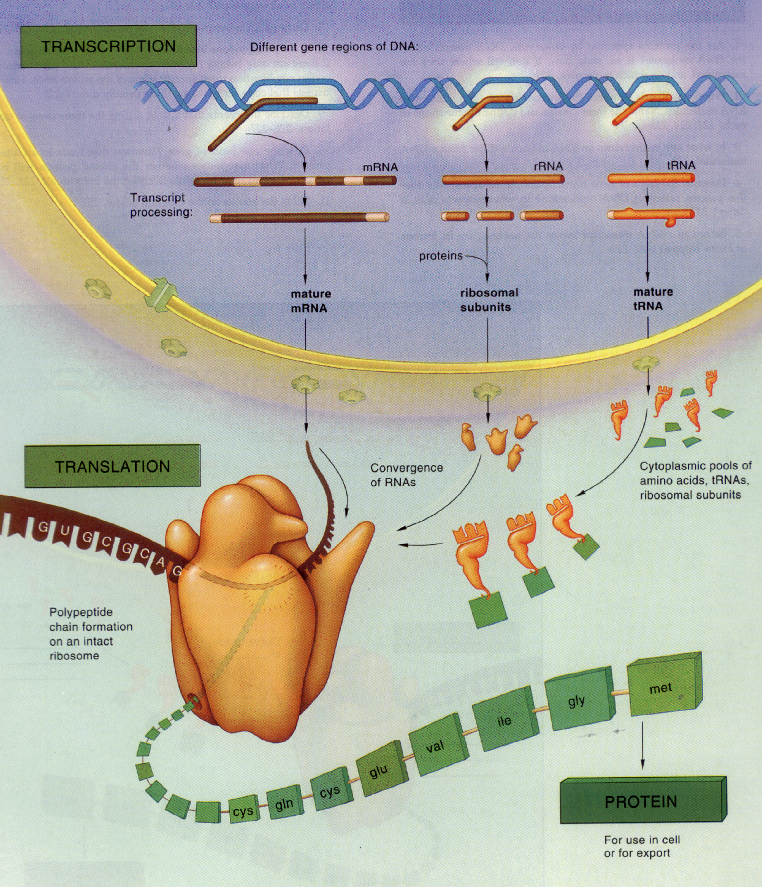
Transcription,
Migration,
& Translation for Protein Building

Slide 26


Slide 29
The Marvelous Living Cell
“A living cell is a marvel of detailed and complex architecture. Seen through a microscope there is an appearance of almost frenetic activity. On a deeper level it is known that molecules are being synthesized at an enormous rate. Almost any enzyme catalyzes the synthesis of more than 100 other molecules per second. In ten minutes, a sizable fraction of the total mass of a metabolizing bacterial cell has been synthesized. The information content of a simple cell has been estimated as around 10¹² bits, comparable to about a hundred million pages of the Encyclopedia Britannica.” Sagan, “Life,” Encyclopedia Britannica: Macropaedia 894 (15 ed. 1974)
Notes:
65

Slide 30
The Marvelous Living Cell
Over 200,000 molecules are being built per second
Notes:
66

Slide 31
DNA
But what about junk DNA?
Only about 5% of DNA used for protein building
Some say that DNA is 95% junk. 95% junk!
Notes:
46

Slide 32
Recent Discoveries About the Supposed “Junk DNA”
Evidence that suggests that such DNA is probably functional
  Most non-protein coding DNA is coded into various RNA’s
  Many non-protein-coding DNA sequences are conserved (similar in different organisms)
The Myth of Junk DNA by Dr. J. Wells
Notes:
67

Slide 33
Recent Discoveries About the Supposed “Junk DNA”
Evidence for specific biological functions of non-protein-coding DNA
  RNA’s from this DNA play significant roles in controlling whether, where & to what extent protein-coding regions are transcribed
The Myth of Junk DNA by Dr. J. Wells
Notes:
67

Slide 34
Recent Discoveries About the Supposed “Junk DNA”
Evidence for specific biological functions of non-protein-coding DNA
  Introns have functions
    Rich in splicing-factor recognition sites
    Encode a majority of the small RNA’s
    RNA’s from introns influence gene expression by modifying chromatin
The Myth of Junk DNA by Dr. J. Wells
Notes:
67

Slide 35
Recent Discoveries About the Supposed “Junk DNA”
Densely concentrated, specified information in DNA
  Multiple messages stored in the same sequence of bases
  “Spliceosomes” and “editosomes”
  Code within a code
  Dual and overlapping messages
Signature in the Cell by Dr. S. Meyer
Notes:
67

Slide 36
Recent Discoveries About the Supposed “Junk DNA”
Evidence for specific biological functions of non-protein-coding DNA
  Pseudogenes
    Some have produced functional proteins
    Some produce RNA’s that suppress the expression of their corresponding functional genes.
    Some produce RNAs that increase the expression of their corresponding functional genes
The Myth of Junk DNA by Dr. J. Wells
Notes:
67

Slide 37
Recent Discoveries About the Supposed “Junk DNA”
Evidence for specific biological functions of non-protein-coding DNA
  Repetitive non-protein-coding DNA
    LINEs – Long Interspersed Nuclear Elements
    SINEs – Short Interspersed Nuclear Elements
    ERVs – Endogenous Retroviruses
The Myth of Junk DNA by Dr. J. Wells
Notes:
67

Slide 38
Recent Discoveries About the Cell’s Informational System
A files-within-folders system to make retrieving, manipulating, and expressing information-rich data more efficient
  Similar to words, sentences, & paragraphs
  Genes, gene folders and superfolders, & “isochores” (megafolders)
Signature in the Cell by Dr. S. Meyer
Notes:
67

Slide 39
Signal Received from Space
SETI
Search for Extra - Terrestrial Intelligence
If we received a message from space containing just the genetic code and an explanation of how it is used to build proteins, everyone would conclude the source was intelligent!!
Notes:
68

Slide 40
Intelligent Design or Natural Causes
Which is more reasonable?
“Everywhere we look, from the macroscopic to the microscopic things look like they are MADE”
“A loud, clear, piercing cry of
DESIGN!!”
Darwin’s Black Box by Dr. M. Behe

