Slide 1
Complexity
Argument
From

Slide 2
Belief in God: Is It Reasonable In This Scientific Age?
Ps. 139: 13-16 – “...for I am fearfully and wonderfully made...”
Rom. 1:20 – Argument from design

Slide 3
Belief in God: Is It Reasonable In This Scientific Age?
1 Peter 3:15 - “… always be ready to give a defense to everyone who asks you a reason for the hope that is in you …”

Slide 4
Darwin on Complex Organs
“If it could be demonstrated that any complex organ existed, which could not possibly have been formed by numerous successive, slight modifications, my theory would absolutely break down.”
Origin of Species, p. 219

Slide 5
A Ditch

Slide 6
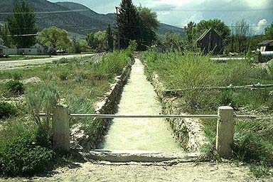
A Wider Ditch

Slide 7
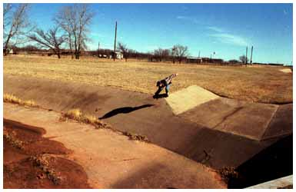
An Even Wider Ditch

Slide 8
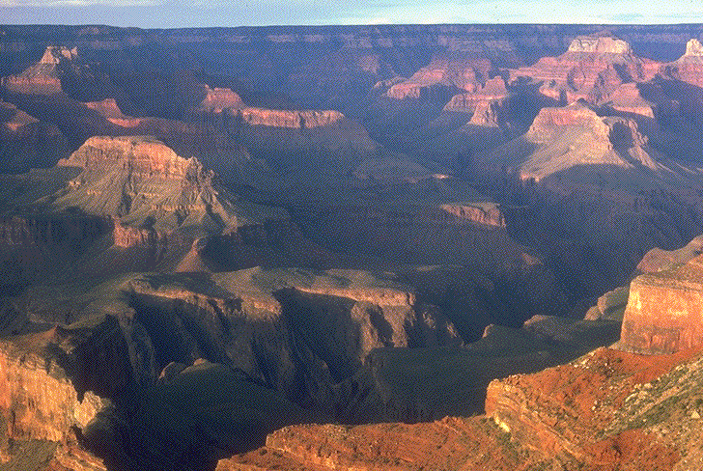
The Grand Canyon

Slide 9
Darwin on the Eye
“To suppose that the eye, with all its inimitable contrivances for adjusting the focus to different distances, for admitting different amounts of light, and for the correction of spherical and chromatic aberration, could have been formed by natural selection, seems, I freely confess, absurd in the highest possible degree.”
Origin of Species, p. 217

Slide 10
Human Eye

Slide 11
Darwin on the Eye
“Yet reason tells me, that if numerous gradations from a perfect and complex eye to one very imperfect and simple, each grade being useful to its possessor, can be shown to exist; if further, the eye does vary ever so slightly, and the variations be inherited, which is certainly the case;

Slide 12
Darwin on the Eye
“and if any variation or modification in the organ be ever useful to an animal under changing conditions of life, then the difficulty of believing that a perfect and complex eye could be formed by natural selection, though insuperable by our imagination, can hardly be considered real.”
Origin of Species, p. 217

Slide 13
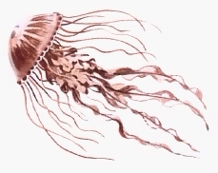
Jellyfish have simple photoreceptors for eyes

Slide 14
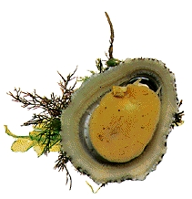
Marine limpets have cupped eyes

Slide 15
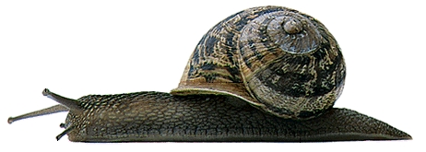
Snails have eyes with lenses

Slide 16
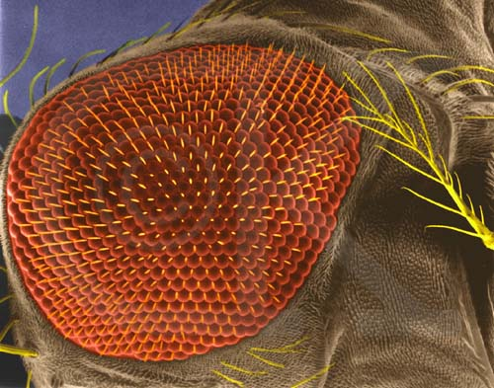
Fruit Fly’s Compound Eye

Slide 17
Honeybee’s Eye

Slide 18
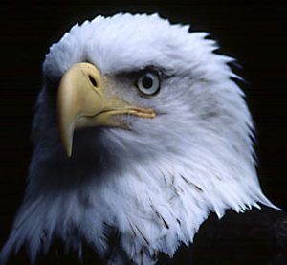
Eagle’s Eye

Slide 19
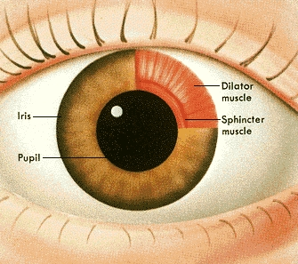
Human Eye

Slide 21
“By irreducibly complex I mean a single system composed of several well-matched, interacting parts that contribute to the basic function, wherein the removal of any one of the parts causes the system to effectively cease functioning.”
page 39

Slide 22
Biochemistry of Vision

Slide 23
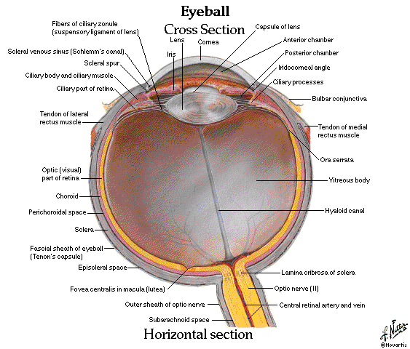

Slide 24
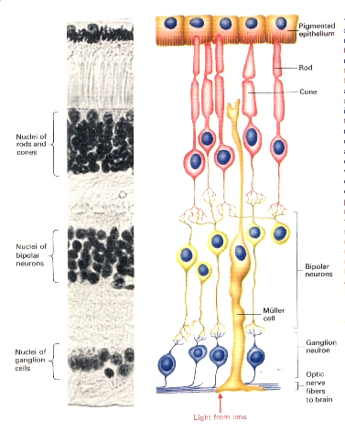
Neural Layer of the Human Retina

Slide 25
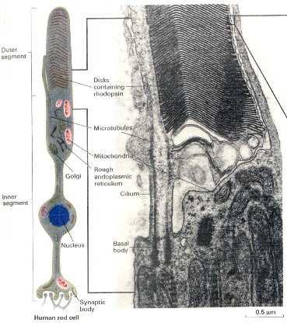
Closer View of the Neural Layer
U
Disk
membrane
U
Na⁺ channel
Rhodopsin
Plasma
Membrane

Slide 26
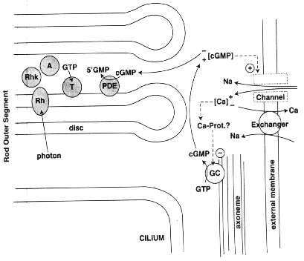

Slide 27
Light
cGMP phosphodiesterase
(active)
Depolarization of plasma membrane
Opens Na⁺ channels
Closes Na⁺ channels
Hyperpolarization of plasma membrane
cGMP (active)
5-GMP (inactive)
Increase in cytosolic Ca²⁺
Opens Ca²⁺ channels
Guanylate
cyclase
GTP
Closes Ca²⁺ channels
Decrease in cytosolic Ca²⁺
Inhibits
Ca²⁺ -sensing
protein
Stimulates

Slide 28
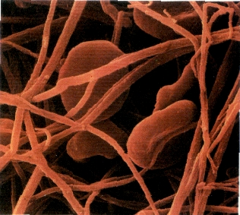
Biochemistry of Blood Clotting

Slide 29
You May Have Watched This...

Slide 30
INTRINSIC PATHWAY
Damaged Surface
Kininogen Kallikrein
EXTRINSIC PATHWAY
XII
XII_{a}
Trauma
XI
XI_{a}
IX
IX_{a}
VII_{a}
VII
VIII_{a}
Tissue factor
Trauma
X
X_{a}
X
V_{a}
Prothrombin (II)
Thrombin (II_{a})
FINAL
COMMON
PATHWAY
Fibrinogen (I)
Fibrin (I_{a})
XIII_{a}
Cross-linked fibrin clot

Slide 31
“These scientific obstacles serve as ‘stark examples of the mountains and chasms that block a Darwinian explanation of life.’”
(page 161)

Slide 32
“The result of these cumulative efforts to investigate the cell - to investigate life at the molecular level - is a loud, clear, piercing cry of ‘DESIGN!’ The result is so unambiguous and so significant that it must be ranked as one of the greatest achievements in the history of science. The discovery rivals those of Newton and Einstein, Lavoisier and Schrodinger, Pasteur and Darwin.

Slide 33
“The observation of the intelligent design of life is as momentous as the observation that the earth goes around the sun or that disease is caused by bacteria or that radiation is emitted in quanta. The magnitude of the victory, gained at such great cost through sustained effort over the course of decades, would be expected to send champagne corks flying in labs around the world.

Slide 34
“This triumph of science should evoke cries of ‘Eureka!’ from ten thousand throats, should occasion much hand-slapping and high-fiving, and perhaps even be an excuse to take a day off.…

Slide 35
“… But no bottles have been uncorked, no hands slapped. Instead, a curious, embarrassed silence surrounds the stark complexity of the cell. When the subject comes up in public, feet start to shuffle, and breathing gets a bit labored. In private people are a bit more relaxed; many explicitly admit the obvious but then stare at the ground, shake their heads, and let it go at that.

Slide 36
Why does the scientific community not greedily embrace its startling discovery? Why is the observation of design handled with intellectual gloves? The dilemma is that while one side of the elephant is labeled intelligent design, the other side might be labeled God.”
(Pages 232-233)

Slide 37
There are many reasons for our hope from examining the natural world! 1 Peter 3:15

