Slide 1
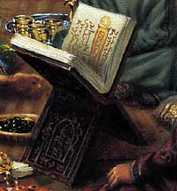
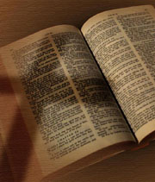
Exploring
Islam & Christianity

Slide 2
Can
Christianity
Survive

Slide 3
“Number of U.S. Muslims To Double”
CURRENT
Projected 2030
U.S. Muslim Population:
2.6 Million
6.2 Million
317 M.
357 M.
Total U.S. Population:
320 Million
363 Million
U.S. Muslims born abroad:
64.5%
55%
Muslim people on earth:
1 out of 6
1 out of 4
Islam’s Dynamic Growth in U.S.
1. Immigration Patterns
2. Higher Birth Rates

Slide 4
Can
Christianity
Survive

Slide 5
Let’s Answer The Threat of Islam As Christians, Not Americans

Slide 6
Let’s Answer the Threat of Islam As Christians, Not Americans
The Government’s Task: Punish Evil
“For he is God's minister to you for good. But if you do evil, be afraid; for he does not bear the sword in vain; for he is God's minister, an avenger to [execute] wrath on him who practices evil.” (Rom. 13:4)
The real danger Islam poses: Lost Souls!
“For our citizenship is in heaven, from which we also eagerly wait for the Savior, the Lord Jesus Christ” (Phil. 3:20)

Slide 7
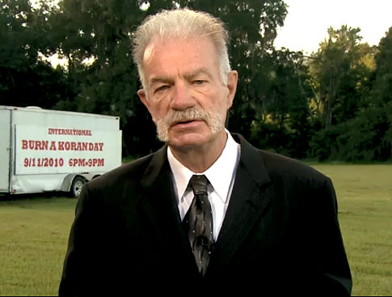
“I have a right to protest – to burn a Qur’an”
Terry Jones

Slide 8
Bible Principles?
"Therefore, whatever you want men to do to you, do also to them, for this is the Law and the Prophets.” (Matt. 7:12)
“All things are lawful for me, but not all things are helpful; all things are lawful for me, but not all things edify.” (1 Cor. 10:23)
“as free, yet not using liberty as a cloak for vice, but as bondservants of God.” (1 Pet. 2:16)

Slide 9
Bible Principles?
"Therefore, whatever you want men to do to you, do also to them, for this is the Law and the Prophets.” (Matt. 7:12)
“All things are lawful for me, but not all things are helpful; all things are lawful for me, but not all things edify.” (1 Cor. 10:23)
Don’t Burn the Qur’an, Expose it!

Slide 10
What If...
A Popular Book Declared
“Muslims are the worst of creatures”
“Show compassion to one another but be severe to Muslims”
“Muslims are perverse”
“Fight the Muslims around you”
“The punishment for Muslims is to kill or hang them, or have a hand on one side and a foot on the other cut off”

Slide 11
What If...
A Popular Book Declared
“Muslims are the worst of creatures”
COMPARE
Surah 8:55, “Verily the worst of creatures in the sight of God are those who deny (the truth), and will not believe”

Slide 12
What If...
A Popular Book Declared
“Show compassion to one another but be severe to Muslims”
COMPARE
Surah 48:29, “Muhammad is the Prophet of God; and those who are with him are severe with infidels but compassionate among themselves.”

Slide 13
What If...
A Popular Book Declared
“Muslims are perverse”
COMPARE
Surah 9:30, “…The Christians say: “Christ is the son of God.” That is what they say with their tongues following assertions made by unbelievers before them. May they be damned by God: How perverse are they!”

Slide 14
What If...
A Popular Book Declared
“Fight the Muslims around you”
COMPARE
Surah 9:123, “O believers, fight the unbelievers around you, and let them realize that you are firm…”

Slide 15
What If...
A Popular Book Declared
“The punishment for Muslims is to kill or hang them, or have a hand on one side and a foot on the other cut off”
COMPARE
Surah 5:33, “The punishment for those who wage war against God and His Prophet, and perpetrate disorders in the land, is to kill or hang them, or have a hand on one side and a foot on the other cut off, or banish them from the land.”

Slide 16
Let’s Answer The Threat of Islam As Christians, Not Americans

Slide 17
Let’s Answer The Threat of Islam As Evangelists, Not Bystanders

Slide 18
Evangelize Americans

Slide 19
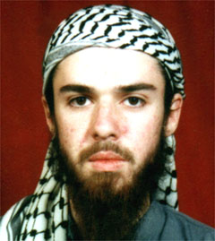
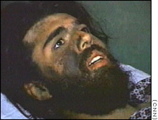
The Case of John Walker Lindh
U.S. citizen Captured in Afghanistan (2001)
Raised in Marin County, CA
Father is Catholic, Mother is Buddhist & Kids should make their own choice on religion
U.S. to Yemen to Taliban to Jail

Slide 20
Did You Know That Muslims Have No Savior?
Allah’s not the savior
The prophet Muhammad is not the savior
Muslims have to save themselves!
“Remember that good deeds nullify the bad” (Surah 11:114)

Slide 21
The Hope of Suicide
The only way the Qur’an assures Paradise: Death in Jihad!
Surah 47:4-6, “So, when you clash with the unbelievers, smite their necks until you overpower them, then hold them in bondage. Then either free them graciously or after taking a ransom, until war shall have come to end. If God had pleased He could have punished them (Himself), but He wills to test some of you through some others. He will not allow the deeds of those who are killed in the cause of God to go to waste. He will show them the way, and better their state, And will admit them into gardens with which he has acquainted them.”

Slide 22
The Hope of Suicide
The only way the Qur’an assures Paradise: Death in Jihad!
Surah 3:157-158, “If you are killed in the cause of God or you die, the forgiveness and mercy of God are better than all that you amass. And if you die or are killed, even so it is to God that you will return.”

Slide 23
The Hope of Suicide
The only way the Qur’an assures Paradise: Death in Jihad!
Surah 3:195, “And those who were deprived of their homes or banished in My cause, and who fought and were killed, I shall blot out their sins and admit them indeed into gardens with rippling streams.”

Slide 24
What Can Local Churches Do? Be Evangelistic!
“but if I am delayed, [I write] so that you may know how you ought to conduct yourself in the house of God, which is the church of the living God, the pillar and ground of the truth.” (1 Tim. 3:15)
Preach Jesus Christ, His death & resurrection (1 Cor. 15:1-3).

Slide 25
Qur’an denies Deity of Jesus Christ
“For God the likeness of Jesus is as that of Adam whom He fashioned out of dust and said “Be” and he was.” (Surah 3:59)

Slide 26
Qur’an denies Crucifixion of Jesus
“And because they denied and spoke dreadful calumnies of Mary; And for saying: ‘We killed the Christ, Jesus, son of Mary, who was an apostle of God;” but they neither killed nor crucified him, though it so appeared to them.” (Surah 4:156-157)

Slide 27
Qur’an condemns Christians for “Good Confession”
“The Christians say: “Christ is the son of God.” That is what they say with their tongues following assertions made by unbelievers before them. May they be damned by God: How perverse are they!” (Surah 9:30)

Slide 28
What Can Local Churches Do? Be Evangelistic!
Preach Jesus Christ
Dispel misinformation
It’s not the same God
It’s not the same Jesus
Work with Families – prepare them

Slide 29
Let’s Answer The Threat of Islam As Victors, Not Victims

Slide 30
“For everyone to whom much is given, from him much will be required; and to whom much has been committed, of him they will ask the more.”
- Luke 12:48

Slide 31
Let’s Answer the Threat of Islam as Victors, not Victims
The apostles prayed for Boldness, not survival (Acts 4:29)
Remember the Victory is in Jesus!
“For to me, to live [is] Christ, and to die [is] gain.” (Phil. 1:21)

Slide 32
“[Let your] conduct [be] without covetousness; [be] content with such things as you have. For He Himself has said, "I will never leave you nor forsake you." So we may boldly say: "The LORD [is] my helper; I will not fear. What can man do to me?"
- Hebrews 13:5-6

Slide 33
Christianity
Can
Survive

