Slide 1
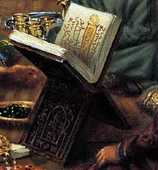
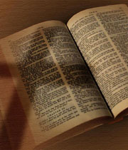
Exploring
Islam & Christianity

Slide 2
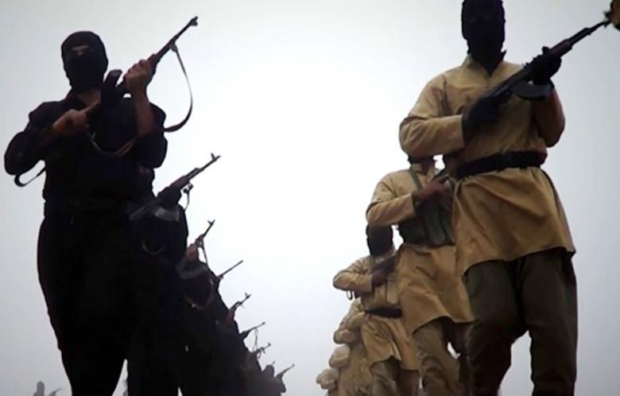

Slide 3
WHEN ISLAM ASKS

Slide 4
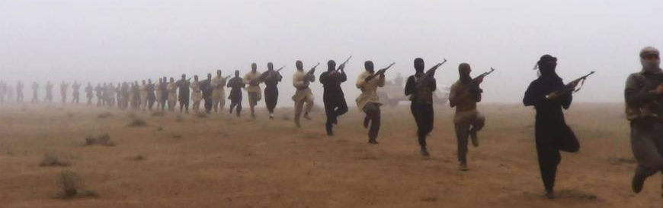
ISIS – “Islamic State of Iraq and al-Sham”
ISIL – “Islamic State of Iraq and al-Levant”
“Islamic State” or “The State” or
“The Caliphate”

Slide 5
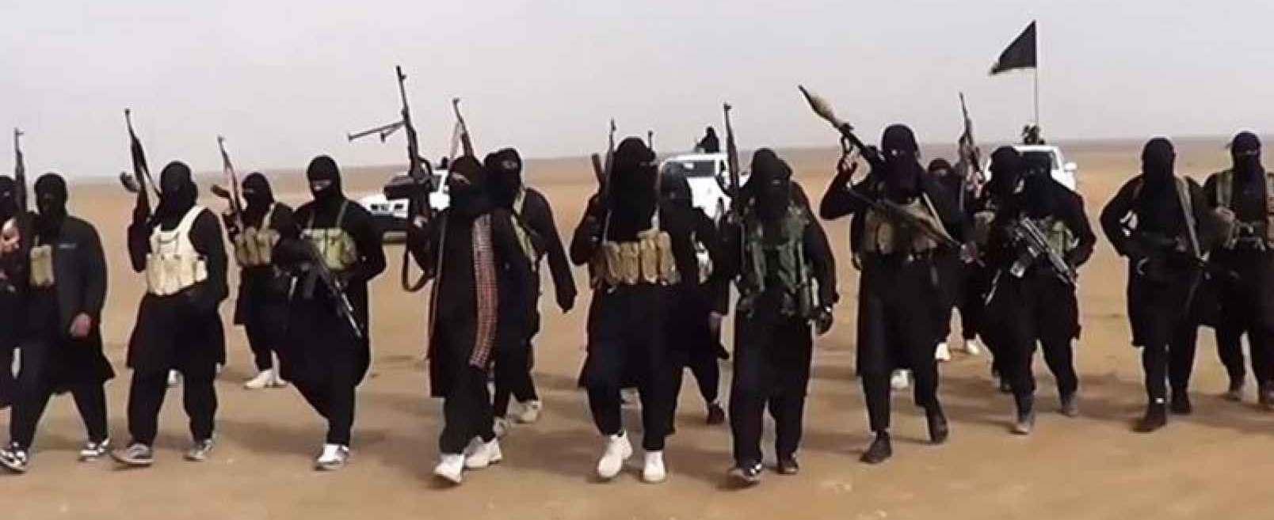
ISIS is a Restoration Movement
ISIS is to the Qur’an
As
churches of Christ are to the Bible

Slide 6
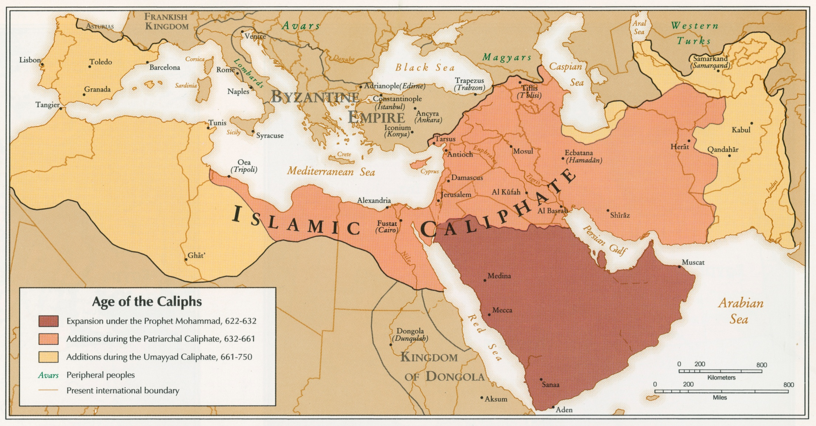

Slide 7
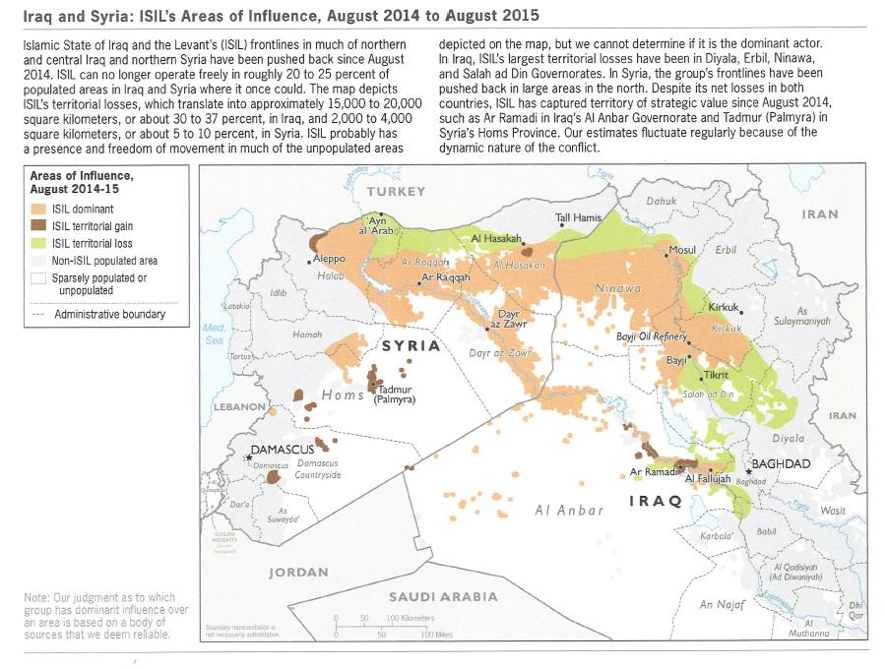
Source: Map and text produced by U.S. Department of Defense, September 2015.

Slide 9
“There would no longer be any Western fingerprint on that map, according to ISIS. Instead there would only be the caliphate. Eventually…if Muslims were strong, the caliphate would again reach Spain and even conquer Rome.” – p.xiii
“ISIS has excelled at couching its struggle in world-historical terms. It has promised both death and a return to the ancient glories of Islam.” – p.242

Slide 10
“[Mother], As you know and watch on television channels, the infidels, and rafida [a bigoted term used to describe the Shia] have gone too far in their oppression, killing, torture and violations of Muslims’ honor. I, by God, cannot see my Muslim sisters and brothers being killed, while some of them appeal to Muslims and find nobody coming to their help, and I sit without doing anything. I wanted to be like al-Muta’sim Billah. And the most important reason is that I longed for heaven, near the Prophet Muhammad, peace be upon him, and I want to ask for forgiveness for you in the afterlife.” – Abdelaziz Kuwan (d. 2014)
WHY?

Slide 11
Surah 47:4
So, when you clash with unbelievers, smite their necks until you overpower them, then hold them in bondage...

Slide 12
“[Mother], As you know and watch on television channels, the infidels, and rafida [a bigoted term used to describe the Shia] have gone too far in their oppression, killing, torture and violations of Muslims’ honor. I, by God, cannot see my Muslim sisters and brothers being killed, while some of them appeal to Muslims and find nobody coming to their help, and I sit without doing anything. I wanted to be like al-Muta’sim Billah. And the most important reason is that I longed for heaven, near the Prophet Muhammad, peace be upon him, and I want to ask for forgiveness for you in the afterlife.” – Abdelaziz Kuwan (d. 2014)
WHY?

Slide 13
“[Mother], As you know and watch on television channels, the infidels, and rafida [a bigoted term used to describe the Shia] have gone too far in their oppression, killing, torture and violations of Muslims’ honor. I, by God, cannot see my Muslim sisters and brothers being killed, while some of them appeal to Muslims and find nobody coming to their help, and I sit without doing anything. I wanted to be like al-Muta’sim Billah. And the most important reason is that I longed for heaven, near the Prophet Muhammad, peace be upon him, and I want to ask for forgiveness for you in the afterlife.” – Abdelaziz Kuwan (d. 2014)
WHY?

Slide 14
The Hope of Suicide
The only way the Qur’an assures Paradise: Death in Jihad!
Surah 3:157-158, “If you are killed in the cause of God or you die, the forgiveness and mercy of God are better than all that you amass. And if you die or are killed, even so it is to God that you will return.”

Slide 15
The Hope of Suicide
The only way the Qur’an assures Paradise: Death in Jihad!
Surah 3:195, “And those who were deprived of their homes or banished in My cause, and who fought and were killed, I shall blot out their sins and admit them indeed into gardens with rippling streams.”

Slide 16
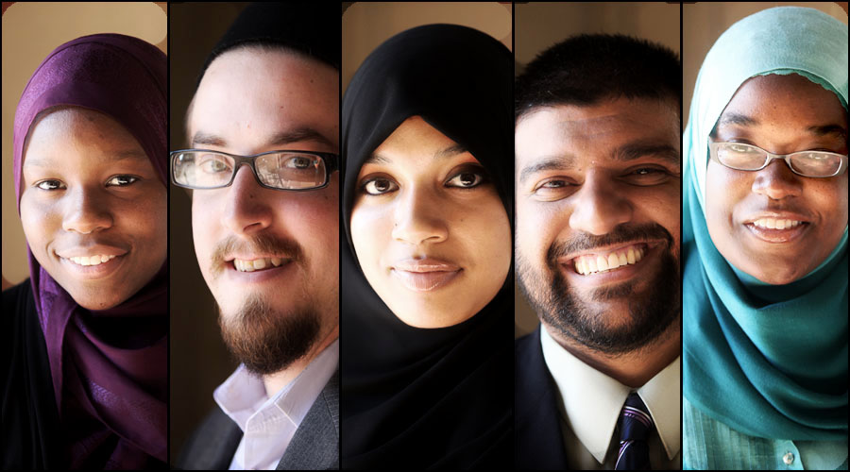

Slide 17
WHEN ISLAM ASKS

Slide 18
1. Questions About God
WHEN ISLAM ASKS

Slide 19
Surah 5: 116
And when God will ask: “O Jesus, son of Mary, did you say to mankind: ‘Worship me and my mother as two deities apart from God?’” (Jesus) will answer: “Halleluja. Could I say what I knew I had no right (to say)?...You know what is in my heart though I know not what You have…”

Slide 20
Surah 4: 171 b
So believe in God and His apostles, and do not call Him ‘Trinity.’ Abstain from this for your good; for God is only one God, and far from His glory is it to beget a son. All That is in the heavens and the earth belongs to Him; and sufficient is God for all help.

Slide 21
Why Should “Trinity” Be Impossible?
Luke 1:37
“For with God nothing will be impossible.”

Slide 22
Why Should “Trinity” Be Impossible?
Isaiah 55:8-9
“For My thoughts are not your thoughts,
​​Nor are your ways My ways,” says the LORD.
“For as the heavens are higher than the earth,
​​So are My ways higher than your ways,
​​And My thoughts than your thoughts.”

Slide 23
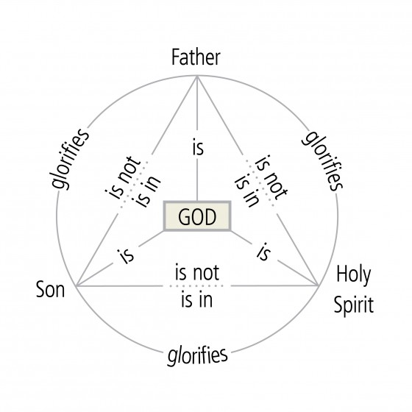
1³ = (1x1x1) = 1
H₂O as Solid, Liquid, & Vapor

Slide 24
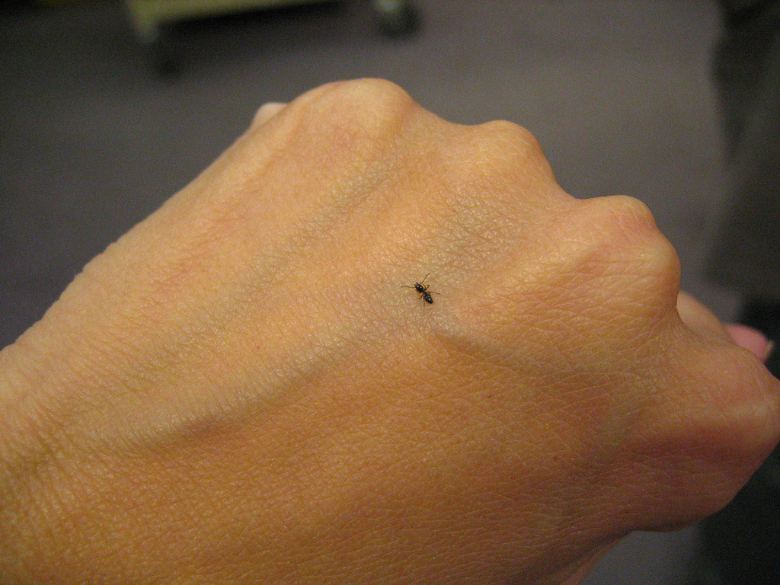
Church Councils discussing “Trinity” did not write or rewrite the Bible; they tried to understand all the Bible said about God.

Slide 25
1. Questions About God
2. Questions About Jesus
WHEN ISLAM ASKS

Slide 26
3
Life – the resurrection of Jesus
Light – The Example of Jesus
Love – the Heart of Jesus

Slide 27
“These converts evidently found something in Christianity that they felt was lacking in Islam. Many are attracted to the figure of Jesus, others find the Christian dogma of forgiveness of sins comforting, and still others are impressed by the charitable behavior of individual Christians around them. But if there is a common thread running through these conversion testimonies, it is that Christianity preaches the love of Christ and God, whereas Islam is forever threatening hellfire for disobeying, and obsessively holds up the wrath of God in front of the believer. In other words, the two religions have two totally different conceptions of God: In the former, God is near, loving, and protective, God the Father, in the latter, God is a remote, angry, tyrannical figure to be obeyed blindly.” – Ibn Warraq, Leaving Islam, p.92

Slide 28
“Muslims are drawn to the love of Christ, and this is a big responsibility as well as a blessing. When I read the New Testament, what amazed and astounded me the most was the teaching on love, not only toward one’s kin and kindred, but even toward one’s enemies. It was so different from my training in Islam that it actually made me angry that someone could suggest something so obviously impossible. But as I continued reading, the reality of it entered my heart and changed my life.” – Sam Soloman, Beyond Opinion, p.78

Slide 29
“After one year of reading the Bible in an honest way, I understand now what happened to me. I found my way to God, the real God, the Lord Jesus Christ. I hope now for all the people I love, my family, my friends, and everyone else to change also and begin to read the Bible in an honest way. I am sure that God will help them find their way.” – Desert Son, Leaving Islam, p.95

Slide 30
“Christianity is life, Islam is death” – an Algerian Muslim convert to Christianity, El Youm (December, 2000)

Slide 31
1. Questions About God
2. Questions About Jesus
3. Questions About Scripture
WHEN ISLAM ASKS

Slide 32
“Have you read the Qur’an?”
“Do you know Arabic?”
“You are quoting the Qur’an out of context!”

Slide 33
Surah 5:32
Whosoever kills a human being… it shall be like killing all humanity; and whosoever saves a life, saves the entire human race.

Slide 34
Surah 5:32
That is why we decreed for the children of Israel that whosoever kills a human being except (as punishment) for murder or for spreading corruption in the land, it shall be like killing all humanity; and whosoever saves a life, saves the entire human race. Our apostles brought clear proofs to them; but even after that most of them committed excesses in the land.

Slide 35
Surah 5:33
The punishment for those who wage war against God and His Prophet, and perpetrate disorders in the land, is to kill or [crucify] them, or have a hand on one side and a foot on the other cut off, or banish them from the land. Such is their disgrace in the world, and in the Hereafter their doom shall be dreadful.

Slide 36
Surah 2:191
And fight those (who fight you) wheresoever you find them, and expel them from the place they had turned you out from. Oppression is worse than killing. Do not fight them by the Holy Mosque unless they fight you there. If they do, then slay them: Such is the requital for unbelievers

Slide 37
Surah 2:216
Enjoined on you is fighting, and this you abhor. You may dislike a thing yet it may be good for you; or a thing may haply please you but may be bad for you. Only God has knowledge and you do not know.

Slide 38
“Have you read the Qur’an?”
“Do you know Arabic?”
“You are quoting the Qur’an out of context!”
“Why are there so many Bibles?”

Slide 39
1. Questions About God
2. Questions About Jesus
3. Questions About Scripture
4. Questions About Muhammad
WHEN ISLAM ASKS

Slide 40
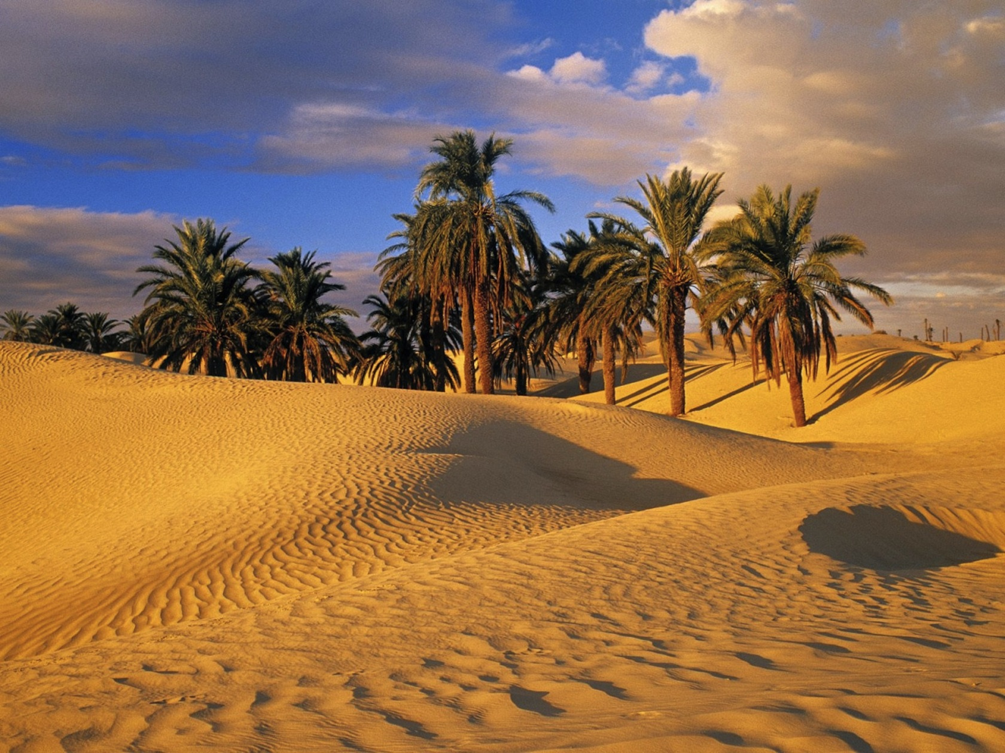

Slide 41
Why can’t you accept Muhammad is a prophet?
Muhammad’s message contradicts the message of the Bible (Gal. 1:8-9).
Muhammad’s example falls short of Jesus.
“So persevere; the promise of God is true; and seek forgiveness for your sins, and chant the praises of your Lord evening and morning” – Surah 40:55

Slide 42
1. Questions About God
2. Questions About Jesus
3. Questions About Scripture
4. Questions About Muhammad
5. Questions About Crusades
WHEN ISLAM ASKS

Slide 43
Don’t both the Bible and the Qur’an promote violence in the name of religion?
1. The OT recorded Judgment on nations not conquer-to-convert tactics.

Slide 44
Surah 5:33
The punishment for those who wage war against God and His Prophet, and perpetrate disorders in the land, is to kill or [crucify] them, or have a hand on one side and a foot on the other cut off, or banish them from the land. Such is their disgrace in the world, and in the Hereafter their doom shall be dreadful.

Slide 45
Surah 5:34
But those who repent before they are subdued should know that God is forgiving and kind.

Slide 46
Surah 9:5
But when these months, prohibited (for fighting), are over, slay the idolaters wheresoever you find them, and take them captive or besiege them, and lie in wait for them at every likely place. But if they repent and fulfill their devotional obligations and pay the zakat, then let them go their way, for God is forgiving and kind.

Slide 47
Don’t both the Bible and the Qur’an promote violence in the name of religion?
1. The OT recorded Judgment on nations not conquer-to-convert tactics.
2. The NT prohibits Christians using violence to force conversions (Matt. 26:52; John 18:36)

Slide 48
Don’t both the Bible and the Qur’an promote violence in the name of religion?
Crusades or Inquisition = Violating Scripture
Jihad or Holy War = Obeying the Qur’an

Slide 49
Surah 9:29
Fight those people of the Book who do not believe in God and the Last Day, who do not prohibit what God and His Apostle have forbidden, nor accept divine law, until all of them pay protective tax in submission.

Slide 50
Surah 9:73
Make War, O Prophet, against the unbelievers and the hypocrites, and deal with them firmly. Their final abode is Hell: And what a wretched destination!

Slide 51
WHEN ISLAM ASKS

