Slide 1
How We Got The Bible
Can We Trust Our
English Versions?
(Part 2)

Slide 2
How We Got Our Bible - Origin
How did we get our Bibles which are so available and useable today?
A long and fascinating story
The Old Testament was written in Hebrew and Aramaic, and the New Testament was written in Greek by about 40 different writers over a period of about 1600 years.

Slide 3
How We Got Our Bible - Origin
How did we get our Bibles which are so available and useable today?
A long and fascinating story
The Old Testament was written in Hebrew and Aramaic, and the New Testament was written in Greek by about 40 different writers over a period of about 1600 years.
We do not possess ANY of the original autographs of either the Old or New Testaments

Slide 4
English Versions of the Bible
How can we be confident that our English versions are trust-worthy, given that:
so much time has passed,
so many things have happened,
and given the difficulty of translating text from one language to another?
A Good Question!

Slide 5
English Versions of the Bible
Some versions should NOT be trusted as careful translations
The New World Translation
Because it was translated by the Jehovah’s Witness organization and thus contains its bias
Example of John 1:1

Slide 6
English Versions of the Bible
Some versions should NOT be trusted as careful translations
The New World Translation
“In the beginning was the Word, and the Word was with God, and the Word was a god.”
John 1:1

Slide 7
English Versions of the Bible
Other versions should be used with careful judgment because of the purpose in their translations.
Several English versions were produced by committees of scholars, but their intent was a “meaning-for-meaning” translation rather than a “word-for-word” translation.

Slide 8
English Versions of the Bible
Other versions should be used with careful judgment because of the purpose in their translations.
Examples of these “meaning-for-meaning” translations are:
The New English Bible (NEB)
The New International Version (NIV)

Slide 9
English Versions of the Bible
The most trustworthy modern English versions are those:
Translated by a large committee of scholars from various backgrounds
Produced with the intent of giving the world an accurate “word-for-word” translation of the best available Greek and Hebrew texts

Slide 10
English Versions of the Bible
Examples of these are the:
King James Version (KJV)
New King James Version (NKJV)
American Standard Version (ASV)
New American Standard Version (NASV)
English Standard Version (ESV)

Slide 11
English Versions of the Bible
Please examine the Preface to your English Bible. My NKJV:
“Complete equivalence seeks to preserve all the information in the text.”
“…appropriate that all participating scholars sign a statement affirming their belief in the verbal and plenary inspiration of Scripture, and in the inerrancy of the original autographs.”

Slide 12
English Versions of the Bible
Please examine the Preface to your English Bible. My NKJV:
“The New King James Version follows the historic precedent of the Authorized Version in maintaining a literal approach to translation, except where the idiom of the original language occasionally cannot be translated into our tongue.”

Slide 13
English Versions of the Bible
But even these English versions present the Bible student with differences.
Variations in English texts because of
Many recent discoveries of ancient manuscripts and other documents
The relative importance given to these by the committees of scholars

Slide 14
English Versions of the New Testament
We will focus on the New Testament as we deal with the question of variations in the text of our English versions of the Bible.
There are variations in text of our English versions of the New Testament because there are variations in the extant Greek manuscripts and ancient versions of the New Testament.

Slide 15
Preservation of Greek New Testament Three Great Witnesses
Manuscripts
Rylands (AD 125)
Vatican (AD 325)
Sinaitic (AD 350)
Alexandrian (400’s)

Slide 16
Transmission of Ancient Documents
Anc. Doc. # of manus. Earliest Extant
Livy’s 20 500 yrs Hist. Of Rome after
Caesar’s 10 900 yrs Gallic Wars after
Tacitus’ 2 800 yrs Annals after
New 5795+ 40 yrs Testament after
Notes:
16

Slide 17
Here’s The Point
1. We can take these 5795+ manuscripts and compare them with each other to ensure what the original text was, even though we do not have the original autographs.
2. There is not another text in all of history that is even in the same “light year” as the New Testament in terms of its textual support.
Notes:
17

Slide 18
Here’s The Point
3. When God chose to preserve His Word He preserved it marvelously compared to anything else that has ever been written in the history of mankind.
1 Peter 1:24-25
Notes:
18

Slide 19
Preservation of Greek New Testament Three Great Witnesses
Manuscripts
Rylands (AD 125)
Vatican (AD 325)
Sinaitic (AD 350)
Alexandrian (400’s)
5791+ Others!

Slide 20
Preservation of Greek New Testament Three Great Witnesses
Manuscripts Versions
Rylands (AD 125) Old Syriac (100’s)
Vatican (AD 325) Old Latin (100’s)
Sinaitic (AD 350) Ethiopic/Coptic
Alexandrian (400’s) Vulgate (402)
5791+ Others!

Slide 21
Preservation of Greek New Testament Three Great Witnesses
Manuscripts Versions Ch. Fathers
Rylands (AD 125) Old Syriac (100’s) Syriac
Vatican (AD 325) Old Latin (100’s) Greek
Sinaitic (AD 350) Ethiopic/Coptic Coptic
Alexandrian (400’s) Vulgate (402) Latin
5791+ Others!

Slide 22
Preservation of Greek New Testament Three Great Witnesses
Early Christian Writers
“…so extensive are the citations that if all other sources for our knowledge of the text of the New Testament were destroyed, they (the citations of the early Christian writers) would be sufficient alone for the reconstruction of practically the entire New Testament.”
Bruce M. Metzger
The Text of the New Testament: Its Transmission, Corruption, and Restoration
3rd Edition. 1992

Slide 23
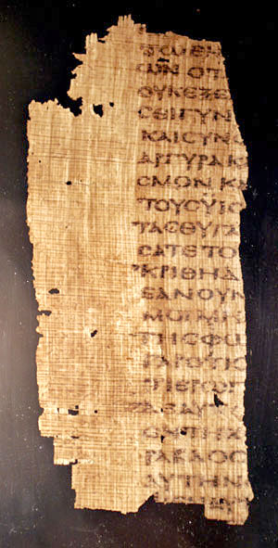
Two Major Types of Manuscripts
Uncials
PAULASERVANTOFJESUSCHRISTCALLEDTOBEANAPOSTLESETAPARTFORTHEGOSPELOFGODWHICHHEPROMISED

Slide 24
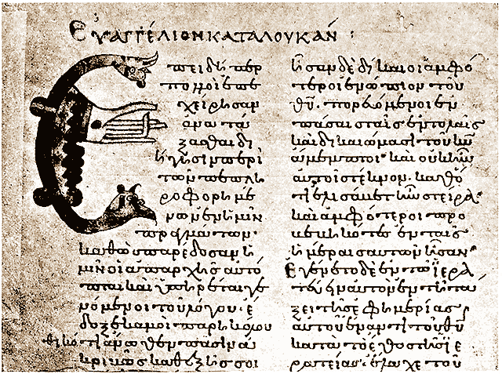
Two Major Types of Manuscripts
Cursives or Miniscules
Smaller letters and cursive like in appearance
Date from the ninth century (A.D. 800’s)
Over 2800 extant

Slide 25
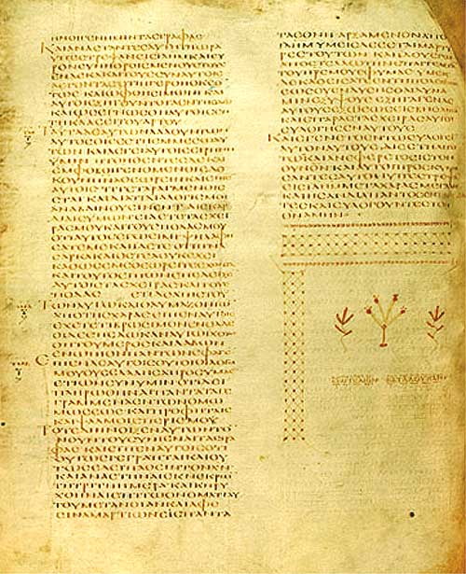
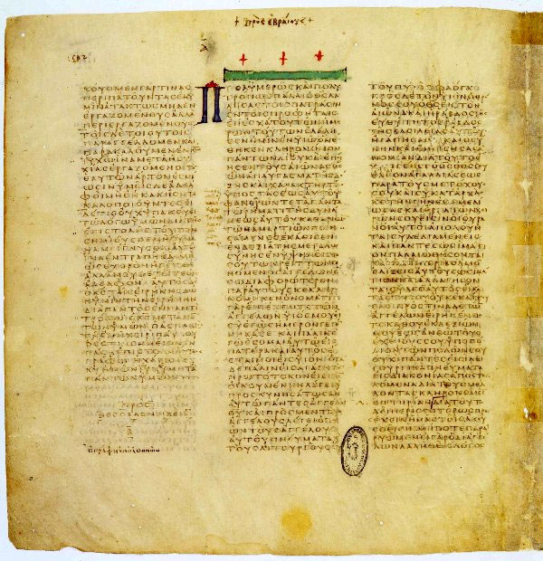
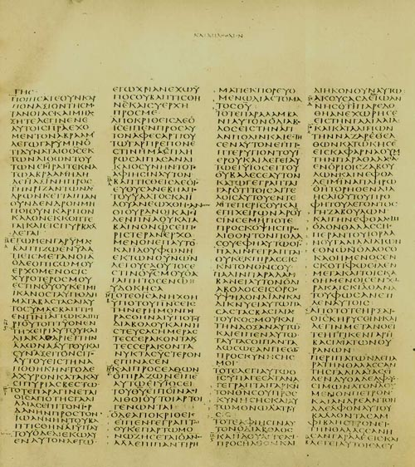
The Most Important Uncials
Oldest vellum manuscripts dating back to A.D. 300-450
Almost complete copies of the New Testament and most of the Old Testament as well
Codex Alexandrinus
Codex Vaticanus
Codex Sinaiticus

Slide 26
Codex Alexandrinus
5th Century
(A.D. 400’s)

Slide 27
Codex Vaticanus
4th Century
(A.D. 300’s)

Slide 28
Codex Sinaiticus
4th Century
(A.D. 300’s)

Slide 29
Preservation of Greek New Testament
The Greek New Testament, divinely inspired in its original autographs, was transmitted to us through the hands of copyists
The manuscripts, ancient versions and the writings of the early Christians were all copied by hand
In some cases copyists were looking at earlier copies as they made their copies

Slide 30
Preservation of Greek New Testament
The Greek New Testament, divinely inspired in its original autographs, was transmitted to us through the hands of copyists
In other cases they were listening to the reading of earlier copies (Scriptoria)
Human copyists are susceptible to slips and faults either of the eye or the ear

Slide 31
Preservation of Greek New Testament
The Greek New Testament, divinely inspired in its original autographs, was transmitted to us through the hands of copyists
Scribes were also sometimes susceptible to trying to improve a text by making it agree with other passages of Scripture.

Slide 32
Preservation of Greek New Testament
The Greek New Testament, divinely inspired in its original autographs, was transmitted to us through the hands of copyists
From one point of view it could be said that there are over 200,000 errors in the Greek New Testament text!
How then can we trust even our modern Greek text?

Slide 33
Preservation of Greek New Testament
This large number of “errors” is gained by counting all the variations in all the manuscripts
For example: The same slight variation might occur in 4000 manuscripts
That would count as 4000 “errors”
This method of counting is misleading!!

Slide 34
Variations in Manuscripts
of the New Testament
No Variations
86% of
New
Testament
(218 of 253 Pages)

Slide 35
Variations in Manuscripts
of the New Testament
(30.5 Pages
of 253)
No Variations
86% of
New
Testament
(218 of 253 Pages)
Spelling
Variations
12%

Slide 36
Variations in Manuscripts of the New Testament
Spelling variations
Often words in Greek copies are spelled differently over a period of years. For example:
“ei” interchanged for “i”
“ai” interchanged for “e”
“Bethzatha” for “Bethesda”

Slide 37
Variations in Manuscripts of the New Testament
(30.5 Pages
of 253)
No Variations
86% of
New
Testament
(218 of 253 Pages)
Spelling
Variations
12%
Minor Var.
1.5%
(3.25 pages)

Slide 38
Variations in Manuscripts of the New Testament
Minor variations
The example of Matthew 1:18
“the birth of Jesus Christ”
“the birth of Christ Jesus”
“the birth of Jesus”
“the birth of Christ”

Slide 39
Variations in Manuscripts of the New Testament
(30.5 Pages
of 253)
No Variations
86% of
New
Testament
(218 of 253 Pages)
Spelling
Variations
12%
Minor Var.
1.5%
(3.25 pages)
Significant
Variations
0.5%
(1.25 pages)

Slide 40
Variations in Manuscripts of the New Testament
Significant variations
The example of Acts 8:37

Slide 41
English Versions of the Bible
Acts 8:37
KJV - “And Philip said, If thou believest with all thine heart, thou mayest. And he answered and said, I believe Jesus Christ is the Son of God.”
NKJV - “*Then Philip said, ‘If you believe with all your heart, you may.’ And he answered and said, ‘I believe that Jesus Christ is the Son of God.’” *8:37 NU, M omit v. 37, It is found in Western texts, including the Latin tradition.

Slide 42
Variations in Manuscripts of the New Testament
Significant variations
The example of Acts 8:37
Support for this verse
One 6th Century Uncial
Some good Miniscules
The Old Latin Version

Slide 43
English Versions of the Bible
Acts 8:37
KJV - “And Philip said, If thou believest with all thine heart, thou mayest. And he answered and said, I believe Jesus Christ is the Son of God.”
NKJV - “*Then Philip said, ‘If you believe with all your heart, you may.’ And he answered and said, ‘I believe that Jesus Christ is the Son of God.’” *8:37 NU, M omit v. 37, It is found in Western texts, including the Latin tradition.

Slide 44
Variations in Manuscripts of the New Testament
Significant variations
The example of Acts 8:37
NU – The Greek text in the 26th edition of the Nestle-Aland Greek New Testament (N) and in the third edition of the United Bible Societies’ Greek New Testament (U).

Slide 45
Variations in Manuscripts of the New Testament
Significant variations
The example of Acts 8:37
M – Majority Text holds that the best Greek text is based on the consensus of the majority of existing Greek manuscripts, even though many are late, and none is earlier than the fifth century.

Slide 46
Variations in Manuscripts of the New Testament
Significant variations
The example of Acts 8:37
Opposition to this verse
Practically all the other manuscripts and versions
No Greek manuscript earlier than the sixth century knows this reading

Slide 47
Variations in Manuscripts of the New Testament
Significant variations
The example of 1 John 5:7-8
Support for these verses as in KJV
Erasmus’ 3rd Edition of the Greek New Testament (Tyndale used this Edition)
Only two manuscripts, one from the 14th or 15th century, and one from the 16th century
Two other manuscripts have this rendition of the verses written in the margin.
Late Latin versions

Slide 48
Variations in Manuscripts of the New Testament
Significant variations
The example of 1 John 5:7-8
Opposition to these verses as in KJV
Practically all the other manuscripts and versions
No Greek manuscript earlier than the 14th century knows this reading

Slide 49
Variations in Manuscripts of the New Testament
Significant variations
The example of Mark 16:9-12
Opposition to this verse
The Vatican and Sinaitic Manuscripts do not have these closing verses
Earliest known copies of the Old Syriac and Latin Vulgate
A large number of Armenian manuscripts

Slide 50
Variations in Manuscripts of the New Testament
Significant variations
The example of Mark 16:9-20
Support for these verses
Almost all other manuscript evidence
Statement from Irenaeus which shows the existence of this passage in the second century

Slide 51
Variations In Manuscripts of the New Testament
(30.5 Pages
of 253)
No Variations
86% of
New
Testament
(218 of 253 Pages)
Spelling
Variations
12%
Minor Var.
1.5%
(3.25 pages)
Significant
Variations
0.5%
(1.25 pages)
NO DOCTRINAL ISSUE AFFECTED!

Slide 52
Preservation of Greek New Testament Three Great Witnesses
Manuscripts Versions Ch. Fathers
Rylands (AD 125) Old Syriac (100’s) Syriac
Vatican (AD 325) Old Latin (100’s) Greek
Sinaitic (AD 350) Ethiopic/Coptic Coptic
Alexandrian (400’s) Vulgate (402) Latin
5656+ Others!

Slide 53
“The interval then between the dates of the original composition and the earliest extant evidence becomes so small as to be in fact negligible, and the last foundation for any doubt that the Scriptures have come down to us substantially as they were written has now been removed. Both the authenticity and the general integrity of the books of the New Testament may be regarded as finally established.” Sir Frederic Kenyon, The Bible and Archeology 1940

Slide 54
English Versions of the Bible
We can have great confidence in the Greek text of the New Testament (and Hebrew text of the Old Testament) that provide the basis for our English versions of the Bible.

Slide 55
English Versions of the Bible
We can also have great confidence in our English versions which were
Translated by large committees of scholars who were committed to giving the world
Accurate “word-for-word” translations of the best available Greek and Hebrew texts.

Slide 56
English Versions of the Bible
“…The word of the Lord endures forever.”
1 Peter 1:25

