Slide 1
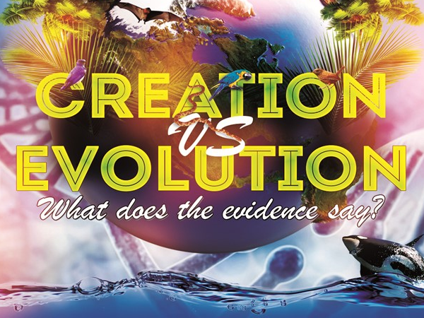
The North Gardendale Church
(www.ngdale.com)

Slide 2
Origins:
Is It Reasonable To Believe in God in This Scientific Age?
Notes:
1

Slide 3
Where Did We Come From?
Only two possibilities
Core Ideas
Proponents of the
General Theory of Evolution
(Natural Causes)
Life, in all its forms, emerged from simple substances by natural means.
Life, in all its forms, is the result of intelligent shaping of matter.
Proponents of Design
(Intelligent Design)

Slide 4
Two basic inferences with regard to the origin of life and its diversity
Both inferences are ultimately positions of faith because
  Origins are not amenable to normal repeatable experimentation or direct observation
  We must use present circumstances to draw inferences about the remote past

Slide 5
The Need for Honesty with Ourselves
We all approach the subject with certain presuppositions
We tend to see what we expect

Slide 6
The Need for Honesty with Ourselves
We all approach the subject with certain presuppositions
We tend to see what we expect
Very emotional topic

Slide 7
We will be looking only at evidence in the natural world

Slide 8
Evidence in the natural world can be used to judge the relative merits of these views

Slide 9
Judge
Intelligent Design
Evolution
Theory
A
Theory
B
EVIDENCE
Facts of nature

Slide 10
Judge
Intelligent Design
Evolution
Which is more reasonable?
Theory
A
Theory
B
EVIDENCE
Facts of nature

Slide 11
Objection
If you bring in intelligent design, you’ve left the field of science.
On the contrary, many fields in science require inferences of intelligent design regularly

Slide 12
Objection
If you bring in intelligent design, you’ve left the field of science.
Anthropology
Archeology
Cryptography
Criminal Forensics
Astro-biologists

Slide 13
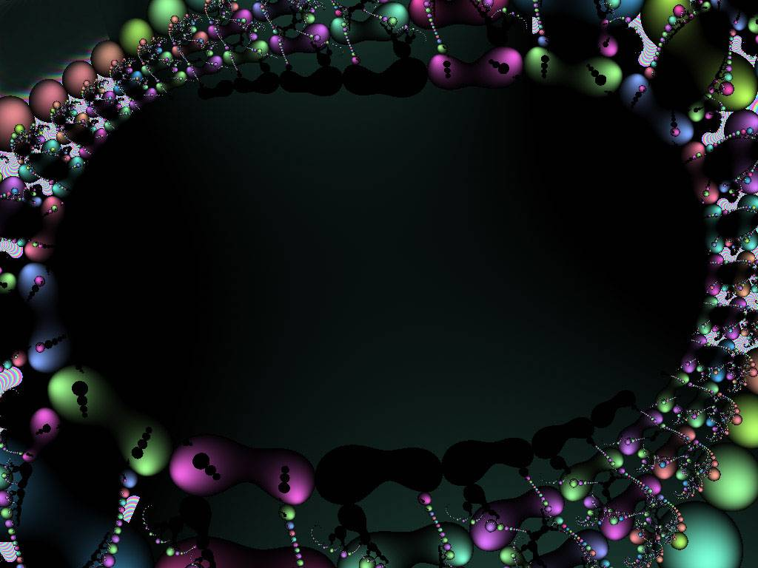
The Design Inference
Seeing Intelligence in the Natural World

Slide 16
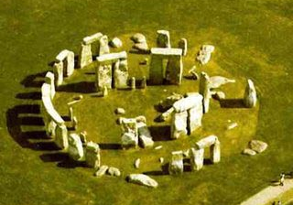
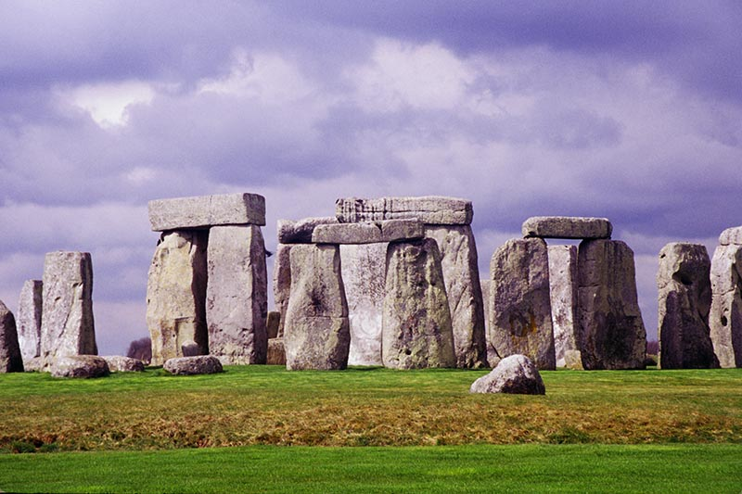
Intelligent Design?
Natural Phenomenon?

Slide 17
Signal Received from Space

Slide 18
Signal Received from Space
SETI
Search for Extra - Terrestrial Intelligence
Intelligent Life in the Universe
I.S. Shklovskii & Carl Sagan
1968

Slide 19
Signs of Intelligent Life in the Universe?
The search for extra-terrestrial intelligence (SETI)
  Supported by your tax dollars for 25 years.
  The program continues to this day with private funding.
What kind of evidence would convince you that there are ET’s?

Slide 20
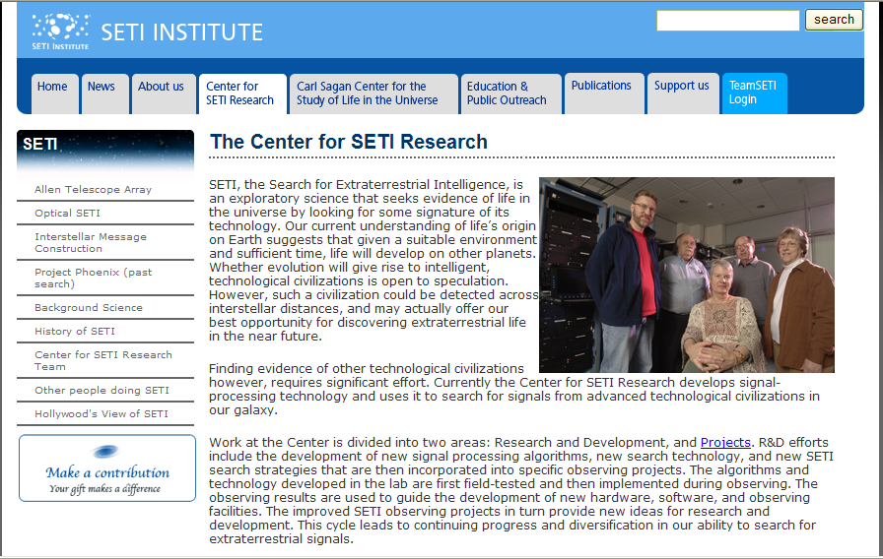
Search for Extra Terrestrial Intelligence - SETI
SETI, the Search for Extraterrestrial Intelligence, is an exploratory science that seeks evidence of life in the universe by looking for some signature of its technology…

Slide 21
From www.seti.org
“Virtually all radio SETI experiments have looked for what are called "narrow-band signals." These are radio emissions that are at one spot on the radio dial… Narrow-band signals… are the mark of a purposely built transmitter. Natural cosmic noisemakers, such as pulsars, quasars… do not make radio signals that are this narrow.”

Slide 22
From www.seti.org
“Virtually all radio SETI experiments have looked for what are called "narrow-band signals." These are radio emissions that are at one spot on the radio dial… Narrow-band signals… are the mark of a purposely built transmitter. Natural cosmic noisemakers, such as pulsars, quasars… do not make radio signals that are this narrow.”
They can infer intelligent cause without identifying what that intelligence is.

Slide 23
What is Intelligent Design (ID)?
A theory for how we may properly conclude something is designed by an intelligent source.
Was this designed?
Two different questions
Who designed this?

Slide 24

By Natural Means?
Make careful observations of its features
Run various chemical and physical experiments

Slide 25
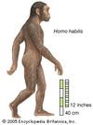
Scraper
By Natural Means?
Make careful observations of its features
Run various chemical and physical experiments
By Intelligence?

Slide 26
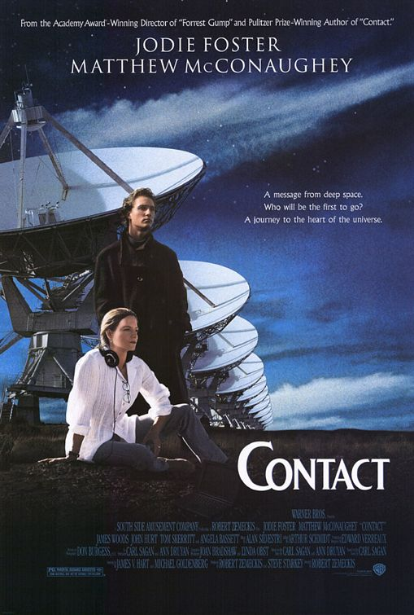
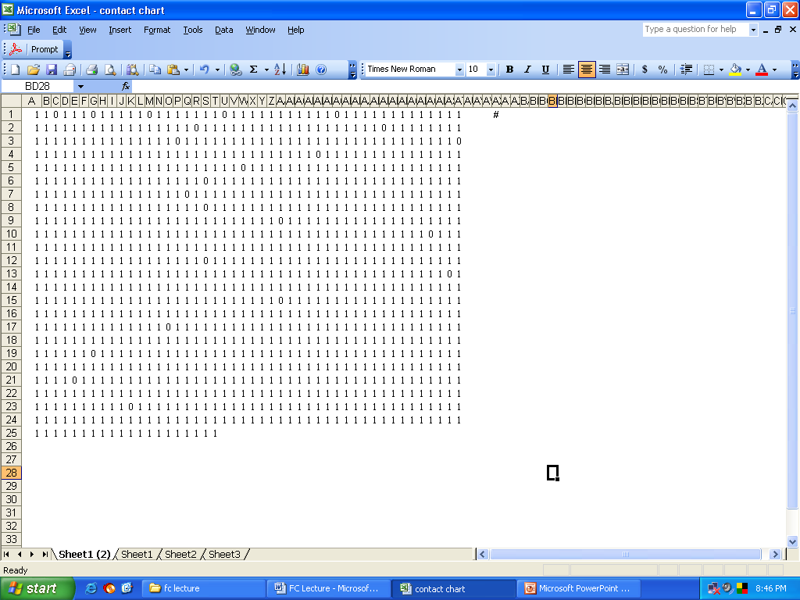

Slide 27
Prime Numbers: 2, 3, 5, 7, 11, 13, 17, 19, … ,101

Slide 28
Prime Numbers: 2, 3, 5, 7, 11, 13, 17, 19, … ,101
This sequence contains the first
25 prime numbers in order!

Slide 29
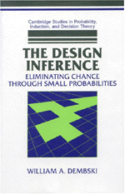
For any event/object, there are only three possibilities:
1) It had to occur, inevitable.
2) It was an accident, pure chance.
3) It was designed.

Slide 30
Event
Intelligent Design, Dembski

Slide 31
Event
Contingent?
NO
Inevitable
YES
Intelligent Design, Dembski

Slide 32
Prime Numbers: 2, 3, 5, 7, 11, 13, 17, 19, … ,101
Clearly, the laws of radio emissions allow a huge number of alternatives to this sequence

Slide 33
Event
Contingent?
NO
Inevitable
YES
Intelligent Design, Dembski

Slide 34
Event
Contingent?
NO
Inevitable
YES
Complex?
NO
Chance
YES
Intelligent Design, Dembski

Slide 35
Complexity
To establish the complexity of this sequence, see the following example:
  Suppose the signal received was
  110111011111
  (12 bits; first three prime numbers)
  While this signal is contingent, it is too simple and could reasonably have been generated by random radio emissions.

Slide 36
Prime Numbers: 2, 3, 5, 7, 11, 13, 17, 19, … ,101
This sequence contains
1,126 bits
and the first
25 prime numbers in order!!

Slide 37
Prime Numbers: 2, 3, 5, 7, 11, 13, 17, 19, … ,101
Thus the sequence is sufficiently complex that it is unreasonable to attribute it to chance.

Slide 38
Start
Contingent?
NO
Inevitable
YES
Complex?
NO
Chance
YES
Intelligent Design, Dembski

Slide 39
Start
Contingent?
NO
Inevitable
YES
Complex?
NO
Chance
YES
Specified?
NO
Chance
YES
Intelligent Design, Dembski

Slide 40
Specificity
To establish the specificity of this sequence we must:
  Show that the pattern in the sequence is independent of the event it describes.
  In other words, side information enables us to construct the pattern in the sequence without recourse to the actual event.

Slide 41
Prime Numbers: 2, 3, 5, 7, 11, 13, 17, 19, … ,101
The pattern of prime numbers in this radio signal can be generated by simply knowing the definition of prime numbers, without any recourse to this radio signal.

Slide 42
Start
Contingent?
NO
Inevitable
YES
Complex?
NO
Chance
YES
Specified?
NO
Chance
YES
Design
Intelligent Design, Dembski

Slide 43
Scientists in Sagan’s fictional novel Contact concluded the signal received on their radio telescopes was from an intelligent source (was designed).
It was contingent
It was complex
It was specified (in advance)

Slide 44
Judge
Natural Causes
Intelligent Design
Which is more reasonable?
Theory
A
Theory
B
EVIDENCE
Facts of nature

Slide 45
Signal Received from Space
SETI
Search for Extra - Terrestrial Intelligence
What if we received a message from space with a language we could decode and read?
Notes:
45

Slide 46
The Issue IS NOT:
Scientific Fact vs. Religious Faith

Slide 47
The Issue IS NOT:
Scientific Fact vs. Religious Faith
The Issue IS:
Which position of faith is more reasonable based on interpretation of data.

Slide 48
The Issue IS NOT:
The evidence (data) obtained from science

Slide 49
The Issue IS NOT:
The evidence (data) obtained from science
The Issue IS:
Which interpretation of the evidence (data) is more reasonable

Slide 50
Judge
Natural
Causes
Intelligent Design
Which is more reasonable?
Theory
B
Theory
A
EVIDENCE
Facts of nature

Slide 51
Points to Remember
We all approach the subject of origins with personal biases.
It is an emotional subject because it has implications far beyond what science can answer.
Science permits any cause, natural or intelligent, if it is supported by uniform sensory experience.
The methods of science and the evidence of the natural world can be used to judge the relative merits of the two views on origins - natural causes (evolution) and intelligent design.
The Design Inference can be analyzed mathematically.
Any position on origins is ultimately a position of faith.

Slide 52
The North Gardendale Church
(www.ngdale.com)

