Slide 3
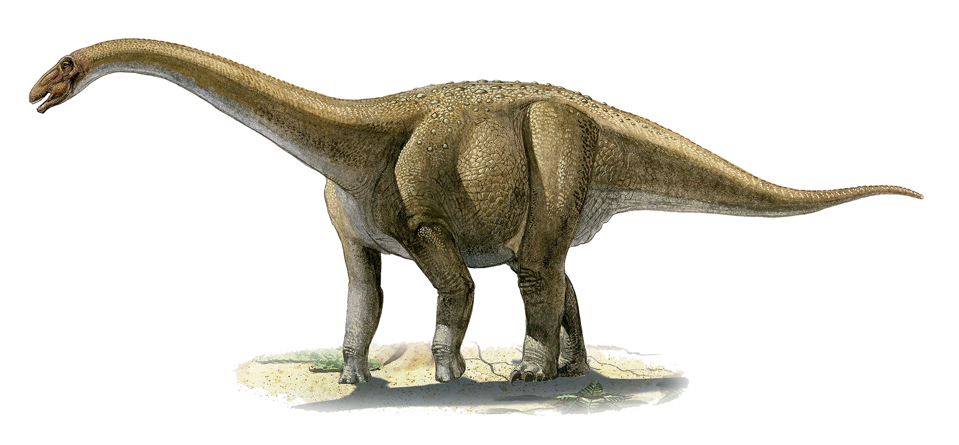
How do you fit dinosaurs into the Bible?

Slide 4
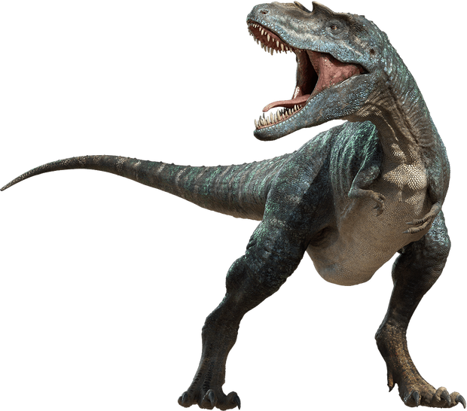
Use the Bible to explain dinosaurs.

Slide 5
Using Biblical Logic
Dinosaurs Were Land Animals
Created on Day 6
Genesis 1:24-25
T-Rex was a land animal
Land animals & man created on Day 6
T-Rex was created on Day 6

Slide 6
Using Biblical Logic
Death
Only Occurred After Sin
Genesis 2:17
Romans 5:12
“Therefore, just as through one man sin entered the world, and death through sin, and thus death spread to all men, because all sinned—”
If this includes animals, dinosaur fossils can’t be millions of years old (Genesis 3:14)

Slide 7
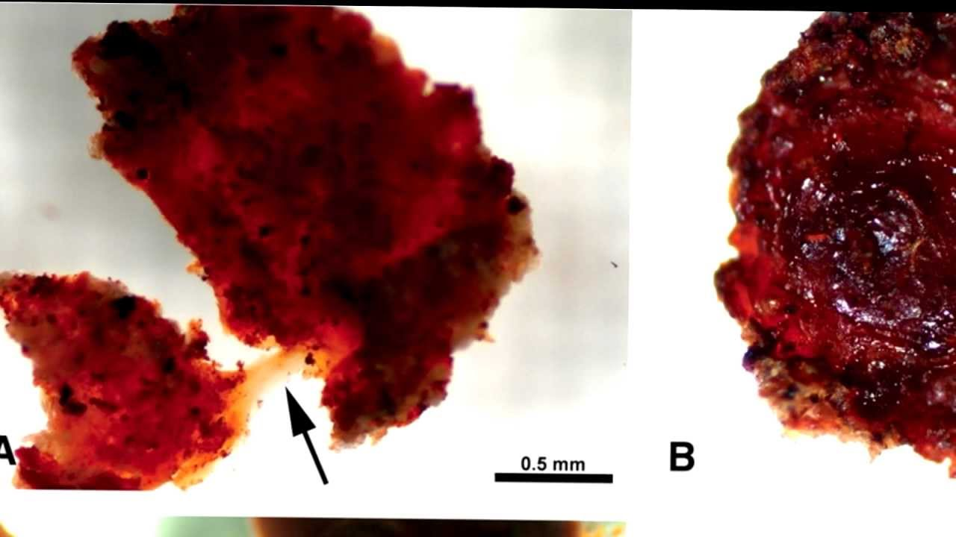
Scientific Evidence Dinosaurs Lived Recently
Red Blood Cells Discovered
Soft-tissue from a T-Rex

Slide 8
Tyrannosaurus Rex
What would he have first eaten?
Plants
Meat
Scavenger
Plants & Meat

Slide 9
Genesis 1:29-30
₂₉ And God said, “See, I have given you every herb that yields seed which is on the face of all the earth, and every tree whose fruit yields seed; to you it shall be for food. ₃₀ Also, to every beast of the earth, to every bird of the air, and to everything that creeps on the earth, in which there is life, I have given every green herb for food”; and it was so.

Slide 11
Black Uakari

Slide 13
Fruit Bat

Slide 14
“Dinosaur” Not in the Bible
Modern Word
Invented in 1841 by Sir Richard Owen
KJV translated into English 1611
230 years before the word existed.
Dragon is in the bible.
Tanniyn “dragon, serpent or sea monster”

Slide 15
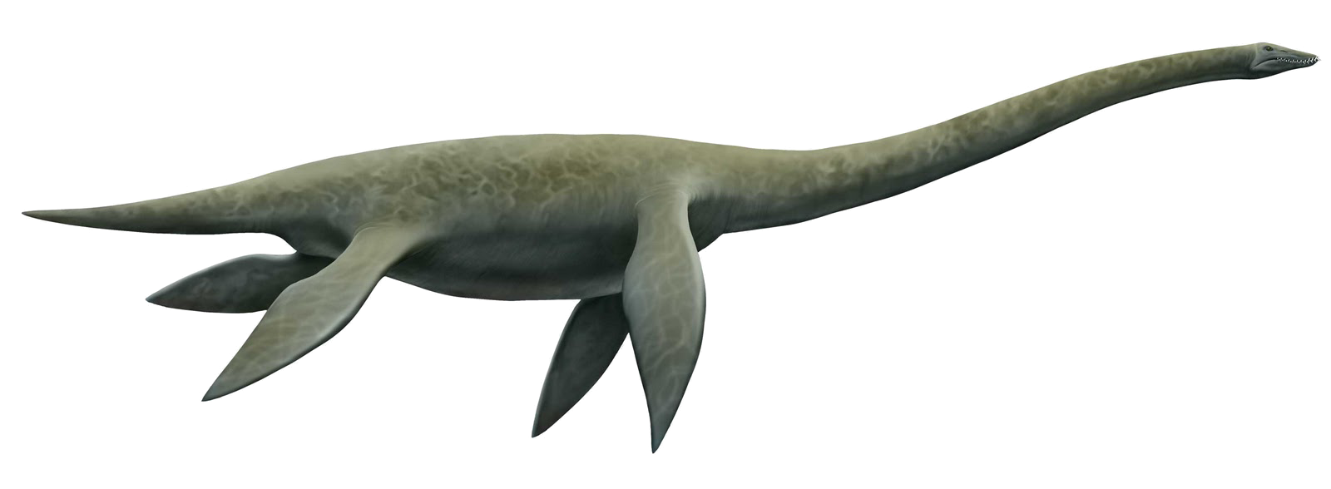
“Dragons” in the Bible
Deut 32:33
Neh 2:13
Job 30:29
Psa 44:19
Psa 74:13
Psa 91:13
Psa 148:7
Isa 13:22
Isa 27:1
Isa 34:13
Isa 35:7
Isa 43:20
Isa 51:9
Jer 9:11
Jer 10:22
Jer 14:6
Jer 49:33
Jer 51:34
Jer 51:37
Eze 29:3
Mic 1:8
Gen 1:21
Ex 7:9
Ex 7:10
Ex 7:12
Job 7:12
Lam 4:3

Slide 16
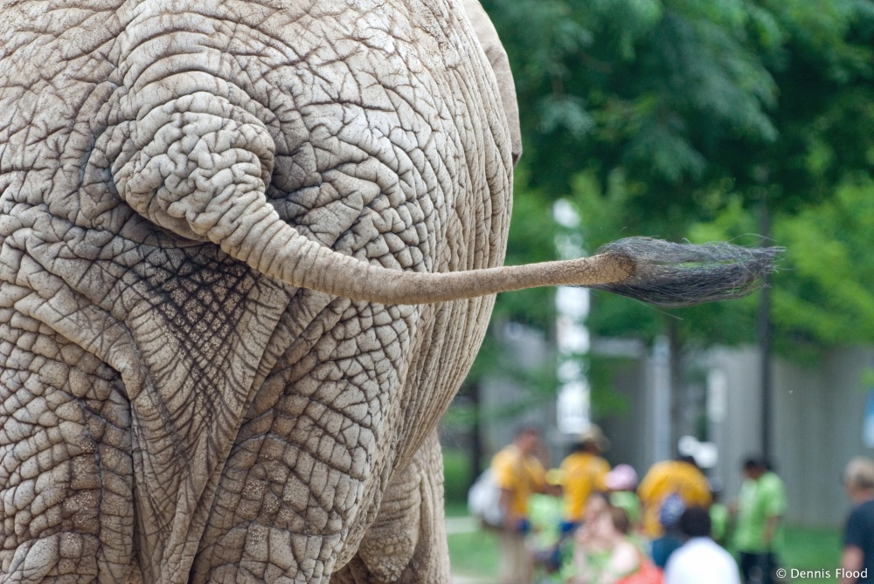
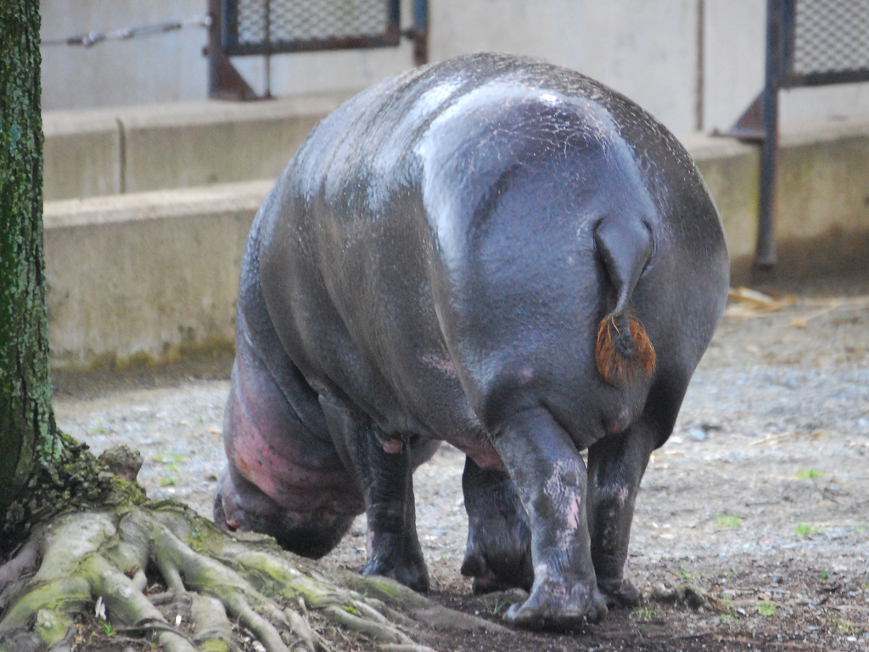
Behemoth: Job 40:15-19
17 He moves his tail like a cedar; The sinews of his thighs are tightly knit.
18 His bones are like beams of bronze, His ribs like bars of iron.
15 “Look now at the behemoth, which I made along with you;
He eats grass like an ox.
16 See now, his strength is in his hips, And his power is in his stomach muscles.
19 He is the first of the ways of God; Only He who made him can bring near His sword.
17 He moves his tail like a cedar; The sinews of his thighs are tightly knit.
Elephant?
Hippo?

Slide 17
Leviathan: Job 41:1-34
1 “Can you draw out Leviathan with a hook, Or snare his tongue with a line which you lower?
15 His rows of scales are his pride, Shut up tightly as with a seal;
16 One is so near another That no air can come between them;
9 “Indeed, any hope of overcoming him is false; Shall one not be overwhelmed at the sight of him?
10 No one is so fierce that he would dare stir him up. Who then is able to stand against Me?
22 Strength dwells in his neck, And sorrow dances before him.

Slide 18
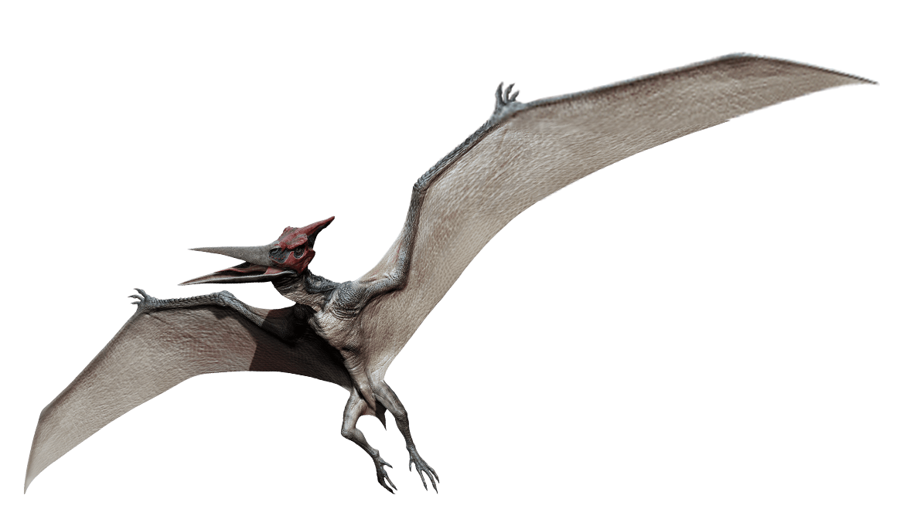
Flying Reptiles
Isaiah 14:29
“And its offspring will be a fiery flying serpent.”
Isaiah 30:6
“The viper and the fiery flying serpent.”

Slide 19
Dinosaurs on Noah’s Ark? Would they fit?

Slide 22
Animals on the Ark
Space Available:
450 ft x 75 ft x 3 decks.= 101,250 ft²
Space Required:
Birds: 2,621 ft² = 2.6%
Mammals: 29,132 ft² = 28.7%
Reptiles: 15,700 ft² = 15.5%
Total: 47,453 ft² = 46.8%
Mammals: 7,428
Birds: 4,602
Reptiles: 3,724
Total: 15,754

Slide 23
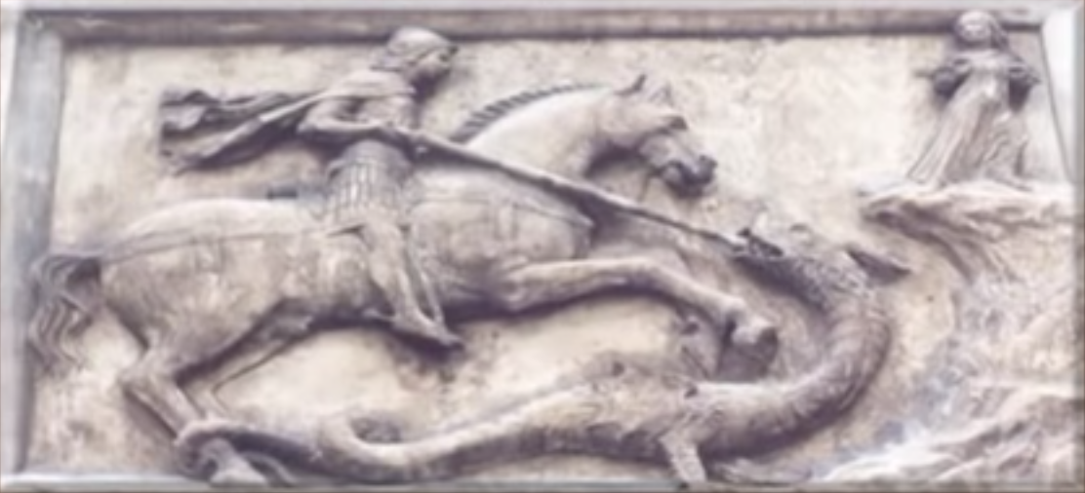
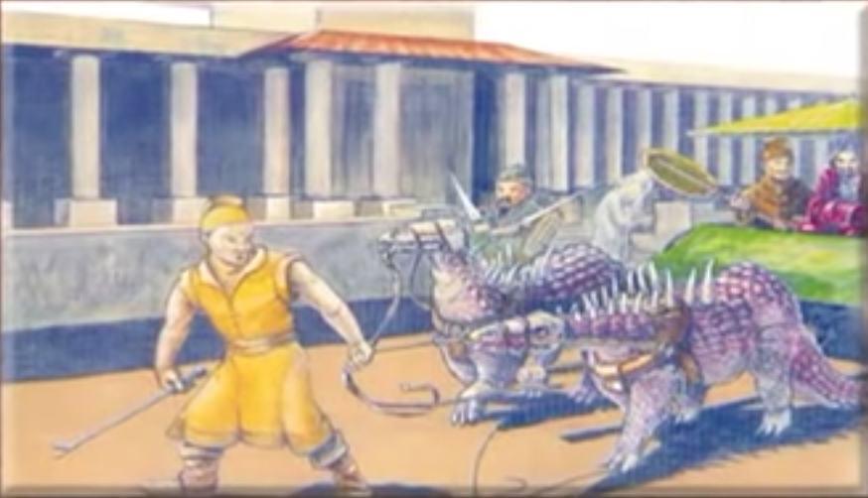
Dragons in History

Slide 24
The city of Nerluc in France was renamed in honor of the killing of a “dragon” there.
The animal is described as being
Larger than an ox and had long, sharp
pointed horns on its head.
TRICERATOPS

Slide 25
Around 900 AD, an Irish writer recorded an encounter with a large animal. The creature had a head shaped somewhat like a horse’s, and had “iron” on its tail that pointed backwards. It had thick legs and strong claws.
The description matches known dinosaurs such as
Stegosaurus and Kentrosaurus.

Slide 26
On May 13, 1572 in Bologna, Italy, a peasant encountered a small hissing “dragon.” The man killed the animal by striking it on the head with his walking stick. He brought the body to a famous naturalist – Ulysses Aldrovandus.
Aldrovandus carefully studied the carcass and reported that it was unquestionably a reptile, one unlike he had ever seen before. It had a long slender neck and a thick body.
The description fits that of a Tanystropheus.

Slide 27
Rhamphorynchus
From Herodotus Book 2:
“There is a place in Arabia not far from
the town of Buto where I went
to learn about the winged
serpents. When I arrived there,
I saw innumerable bones and backbones of many serpents. Many heaps of backbones, great and small and even smaller. Winged serpents are said to fly from Arabia at the beginning of each spring, making for Egypt; but the ibis birds encounter the invaders in the pass and kill them.”
“The serpents were like water snakes. Their wings were not feathered but very like that wings of a bat.”

Slide 28
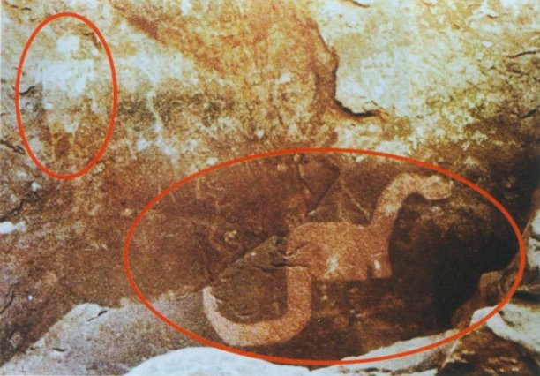
Ancient Dinosaur Drawings

Slide 29
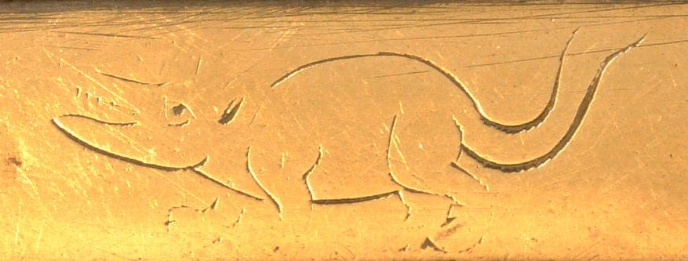
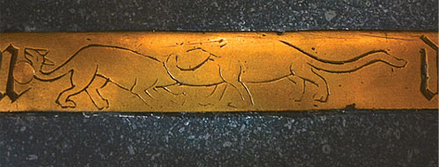
Bishop Bell’s tomb in Carlisle Cathedral

Slide 30
Australian aborigines “painted a plesiosaur-type creature “ Yarru,” by the Kuku Yulanji tribespeople of far North Queensland, Australia.

Slide 31
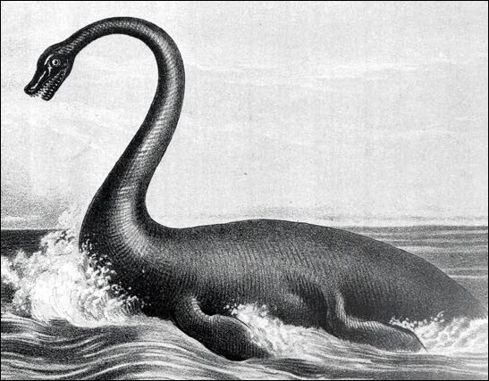
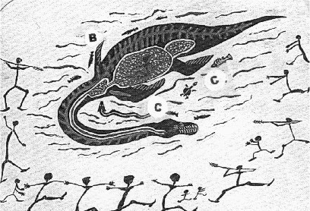
Mirreeulla: A mighty creature resembling a plesiosaur is often reported in the Hawesbury river near Sydney. The reports go back several centuries; some estimate that the creature is up to 50 feet long.
Yarru (or Yarrba): The Australian Aborigines have reports of this animal living in Lake Galilee (in western Queensland). Oral tradition describes the creature as being 20-30 feet in length with a long serpent-like neck attached to a large, bulky body and two pairs of flippers.

Slide 32
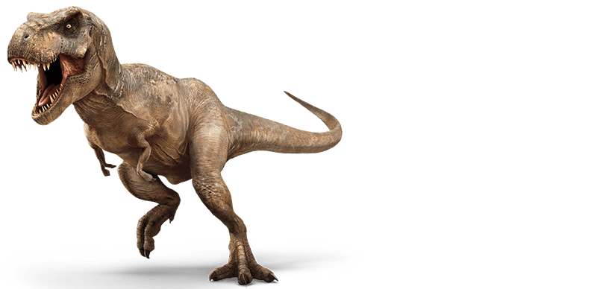
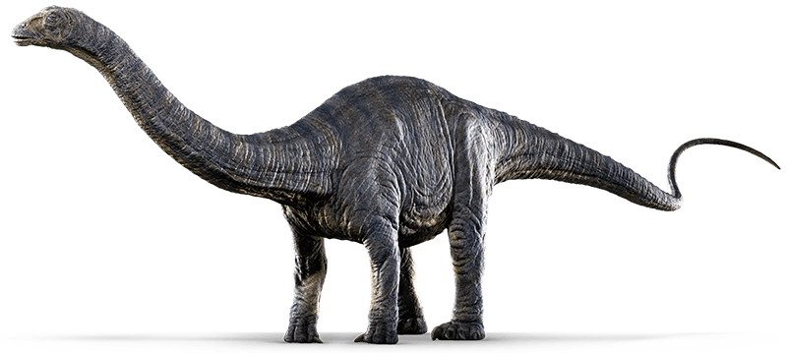
Bunyip: An Australian Aboriginal word for “monster.” The descriptions and sketches resemble a large bipedal reptile such as Tyrannosaurus or allosaurus.
Mokele-mbembe: This large creature is said to exist in the African Congo and eye-witness reports are as recent as 1990. The descriptions and sketches resemble a sauropod dinosaur.

Slide 33
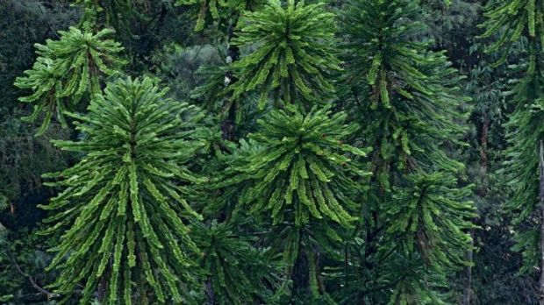
Wollemi Pine

Slide 34
What Killed the Dinosaurs?
Why do animals become extinct?
Disease
Famine
Hunted to extinction
Changes to environment

Slide 35
Conclusion
Romans 1:20 (NKJV) “For since the creation of the world His invisible attributes are clearly seen, being understood by the things that are made, even His eternal power and Godhead, so that they are without excuse,”
Job 12:7-10 (NKJV) 7“But now ask the beasts, and they will teach you; And the birds of the air, and they will tell you; 8 Or speak to the earth, and it will teach you; And the fish of the sea will explain to you.9 Who among all these does not know That the hand of the Lord has done this, 10 In whose hand is the life of every living thing, And the breath of all mankind?”

